Slide 1
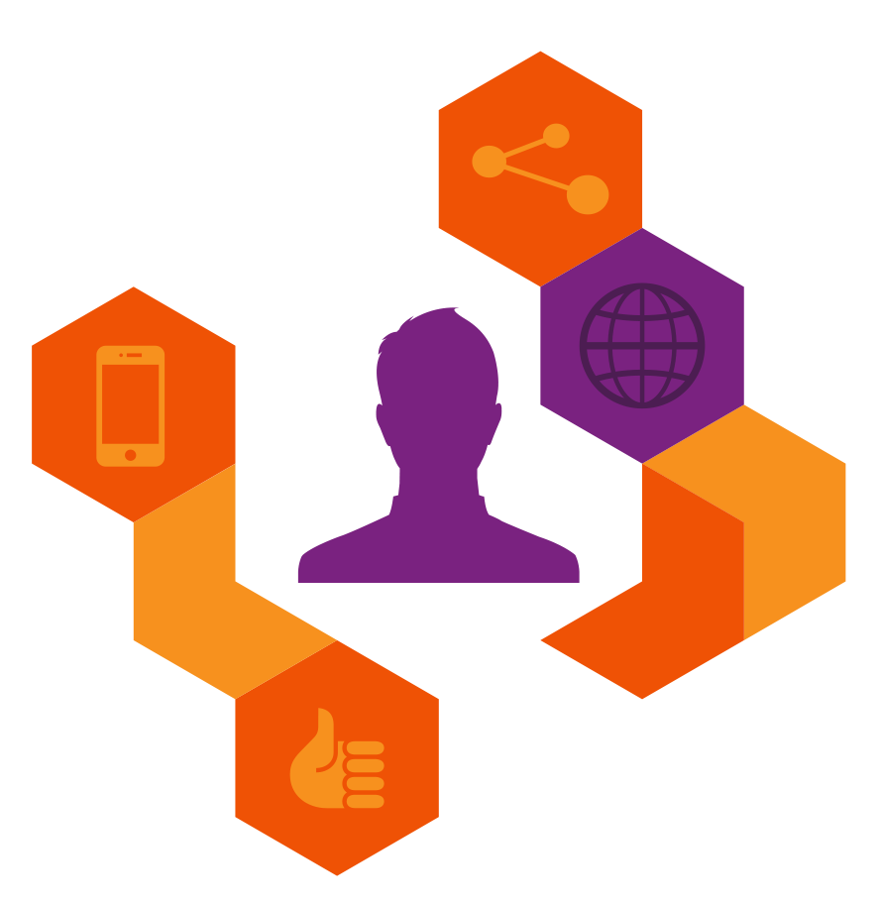
De-averaging the connected consumer
Notes:
Welcome and introduction slide

Slide 2
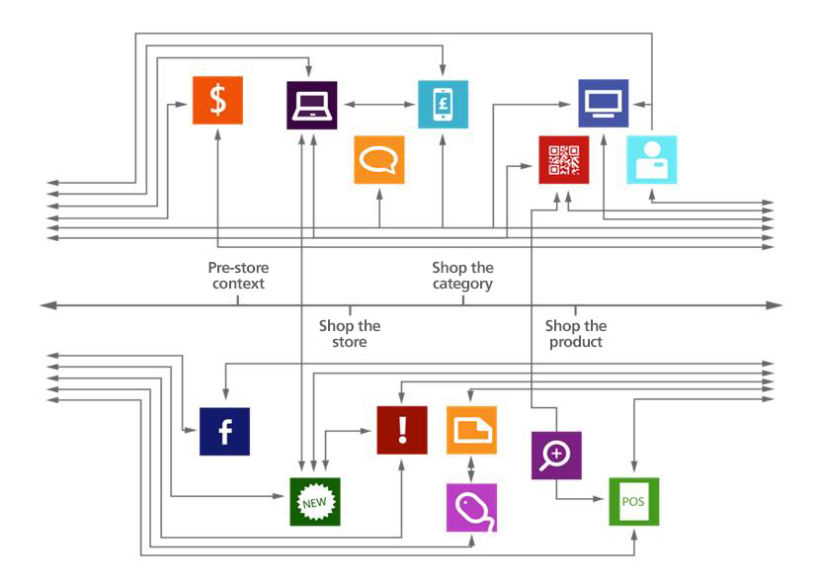
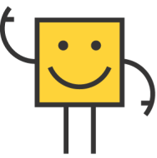
Social media Social media Social media…
Blah blah blah…
Need
Purchase
Notes:
I’m sure we’ve all seen slides like this before, and the usual storyline is one of consumers racing ahead, marketers struggling to keep up, and solution is always to buy in to whatever solution the speaker is selling

Slide 3
The real challenge is not to keep up with the fastest adopters, but to plan for sheer diversity
Weekly digital activities - Global
%
Information seeking
Entertainment
Communication
Social
Younger (16-24 years)
Older (55-65 years)
SOURCE: Connected Life
Notes:
The reality is far more complex than that. As we can see from this simple chart, the digital footprints of different consumer groups highlight the substantial diversity that we now see. Speaking to both the fastest adopters and the slower movers is the real challenge

Slide 4
But how do you prioritise?
16-24 years old
Flight buyers
55-65 years old
Flight buyers
Share of media
time online (%)
38%
79%
Proportion with
high income (%)
26%
38%
Source: Connected Life
Notes:
But equally there are others with no interest whatsoever in the content you produce, no matter how good. The less advanced and older groups are also often the wealthiest, so the challenge is clear; how do you prioritise?

Slide 5
This isn’t just about differences between age groups. The ‘average’ always hides diversity
Hours per day – 16-24s [Norway]
1hr
Least connected (10%)
3hrs
Average score
14hrs
Most connected (1%)
Source: Connected Life
Notes:
There’s also more nuance than we’ve been led to believe in this story about younger groups, millenials, digital natives. They are more active as a target, but, even amongst this faster moving group we find substantial diversity

Slide 6
Four opportunities to focus on instead
New ways to
segment
New ways to target consumers
New touchpoint priorities
New way to target moments
Notes:
The more we de-average our approach to marketing, the more we can achieve. We’ll spend the rest of today discussing four distinct areas of opportunity that only exist because we’re able to take advantage of new consumer behaviours, and the diversity that now exists in the market
[Link topic to rest of agenda using this slide]
‘We’ll cover more on how to market to these groups in the marketing in a connected world session. We’ll look at new business models that only exist because a portion of a de-averaged market has decided to buy their razorblades online’ etc

Slide 7
There is a smarter way to target
High
Observers
Leaders
28%
18%
Digital
influence
37%
18%
Low
Functionals
Connectors
Low
Social engagement
High
Source: Connected Life

Slide 8
They can be found in different places
Share of time spent on devices and media among segments [NORWAY}
Functionals
Connectors
Observers
Leaders
Share of time
on devices (%)
Share of time
on media (%)
Media
Devices
Source: Connected Life
Notes:
The original challenge we started with was ‘how to keep up with the fastest adopters’, and that still is a challenge. But when we de-average and segment we do uncover insights that we can use to do so

Slide 9
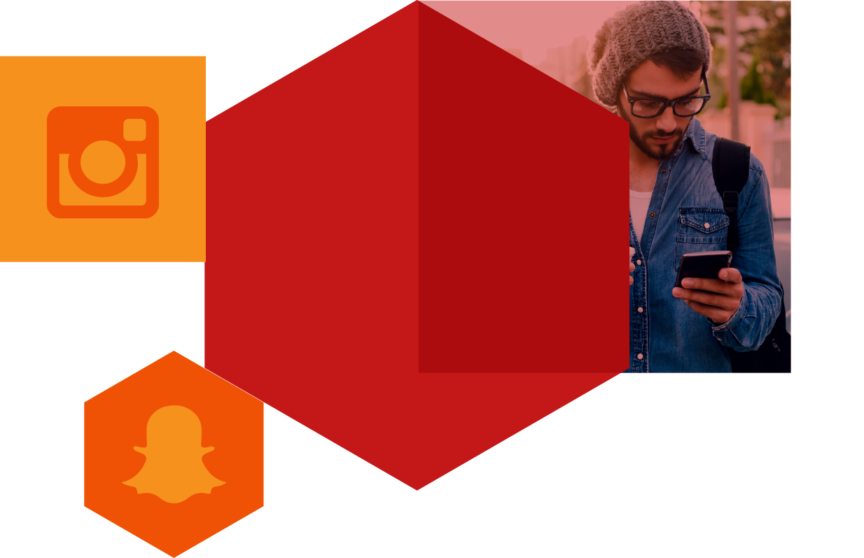
And react very differently to brand content
“I like what I am seeing with ads on snapchat ...
and same with Instagram. I even find myself following brands pages or snap feeds just because I am a fan of how they use the medium.”
(Mexico)
Source: Connected Life
Notes:
They actually consume the largest amount of content and are appreciative of good ads! This particular respondent went on to reference the longer story arcs and greater creative value of Taco Bell content on Snapchat, so there is a sophisticated, content-hungry audience out there

Slide 10
Four opportunities to focus on instead
New ways to
segment
New ways to target consumers
New touchpoint priorities
New way to target moments
Notes:
The more we de-average our approach to marketing, the more we can achieve. We’ll spend the rest of today discussing four distinct areas of opportunity that only exist because we’re able to take advantage of new consumer behaviours, and the diversity that now exists in the market
[Link topic to rest of agenda using this slide]
‘We’ll cover more on how to market to these groups in the marketing in a connected world session. We’ll look at new business models that only exist because a portion of a de-averaged market has decided to buy their razorblades online’ etc

Slide 11
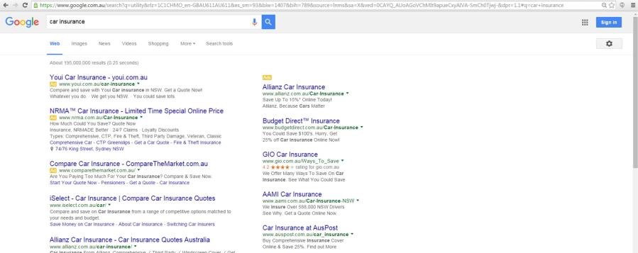



Programmatic is problematic
Notes:
This is one of the most problematic areas for marketing.
Programmatic is a major area of focus but it is problematic:
So retargeting against ‘behavioural intent’ – such as searching for a brand, visiting a category site etc. is indeed in many instances, a waste of time.
It is too late in the purchasing process
And as every brand is doing this, it is too competitive – everyone is buying the same behavioural target.

Slide 12
The majority are not ‘influenced’ by their journey
51%
Choose the brand of product they buy before they even start researching
Source: Connected Life
% who have made mind up on brand (pre-research)
Notes:
Key Points to make:
You see, in many instances, people have made their mind up on what brand they’re going to buy long before they start the research process
Of course it depends on the shopper mission, but these are average scores across a range of categories
And even if they haven’t made their mind up on the exact brand, most often they will have a limited repertoire
You’ll hear more about this later on (name session) but it is now possible to target these mindsets specifically dramatically enhancing the effectiveness of your digital changes

Slide 13
It’s a marketplace

Slide 14
What if you could instead advertise just to those who were already pre-disposed to your brand?
34

Slide 15
We’ve started doing this for brands, and using lookalike modelling to buy media against those consumer groups
Ad
Ad
Internet behaviour
Look-alike model
Ad
Purchase behaviour
Ad
35
Notes:
We then used lookalike modelling to allow the client to buy against the entire universe; dramatically dropping the cost of the ad real estate whilst also targeting the right audience far more effectively

Slide 16
Targeting higher up the funnel
36

Slide 17
HOTEL
+38%
+500%
Consideration
Sales
(vs. behavioural targeting)
Source: TNS case study
37

Slide 18
Four opportunities to focus on instead
New ways to
segment
New ways to target consumers
New touchpoint priorities
New way to target moments
Notes:
The more we de-average our approach to marketing, the more we can achieve. We’ll spend the rest of today discussing four distinct areas of opportunity that only exist because we’re able to take advantage of new consumer behaviours, and the diversity that now exists in the market
[Link topic to rest of agenda using this slide]
‘We’ll cover more on how to market to these groups in the marketing in a connected world session. We’ll look at new business models that only exist because a portion of a de-averaged market has decided to buy their razorblades online’ etc

Slide 19
Do fewer things better
Shelf presence in supermarkets
POS
Promotion stands in supermarkets
TV ads
Print ads
Family and friends recommendation
Coffee used in gastronomy
Supermarket flyers
Billboard ads
Product usage
Source: TNS case study
Notes:
A good starting point it to recognise that not all touchpoints are equal. They won’t all deliver value.
So rather than trying to be everywhere and diluting your marketing budget, focus on doing a few things excellently.
In this example from the coffee markets, we see that just 10 of the touchpoints are delivering over 80% of the impact. Others are making a negligible contribution AND some are even having a negative impact (sales promotions!)
And if you’re not trying to get your message out across all available touchpoints you can ensure that you do a few things excellently and optimise their impact further.

Slide 20
And make them count – every touchpoint is becoming multi-modal
47%
34%
23%
Brand Building
Connecting with brands
on Facebook
Converting
Using social
in P2P
Servicing
Seek service solutions
via social
Source: Connected Life
Notes:
And this is critical as touchpoints need to fulfill many roles. We used to think of touchpoints serving a particular purpose – reach, engagement for conversion, but that is also no longer the case.
This can be demonstrated by looking a one such touchpoint – social which people to connect with brands, but also (and increasingly) to influence purchases and to ask service questions. Brand owners need to allow of all of these scenarios to be happening simultaneously
People don’t operate in silos / compartmentalise their experiences and decisions
Touchpoints can no longer be ‘owned’ by a single function within an organisation – they need to work together to fully flex. It’s not about brand marketing, shopper marketing, customer, marketing – it’s the total customer experience

Slide 21
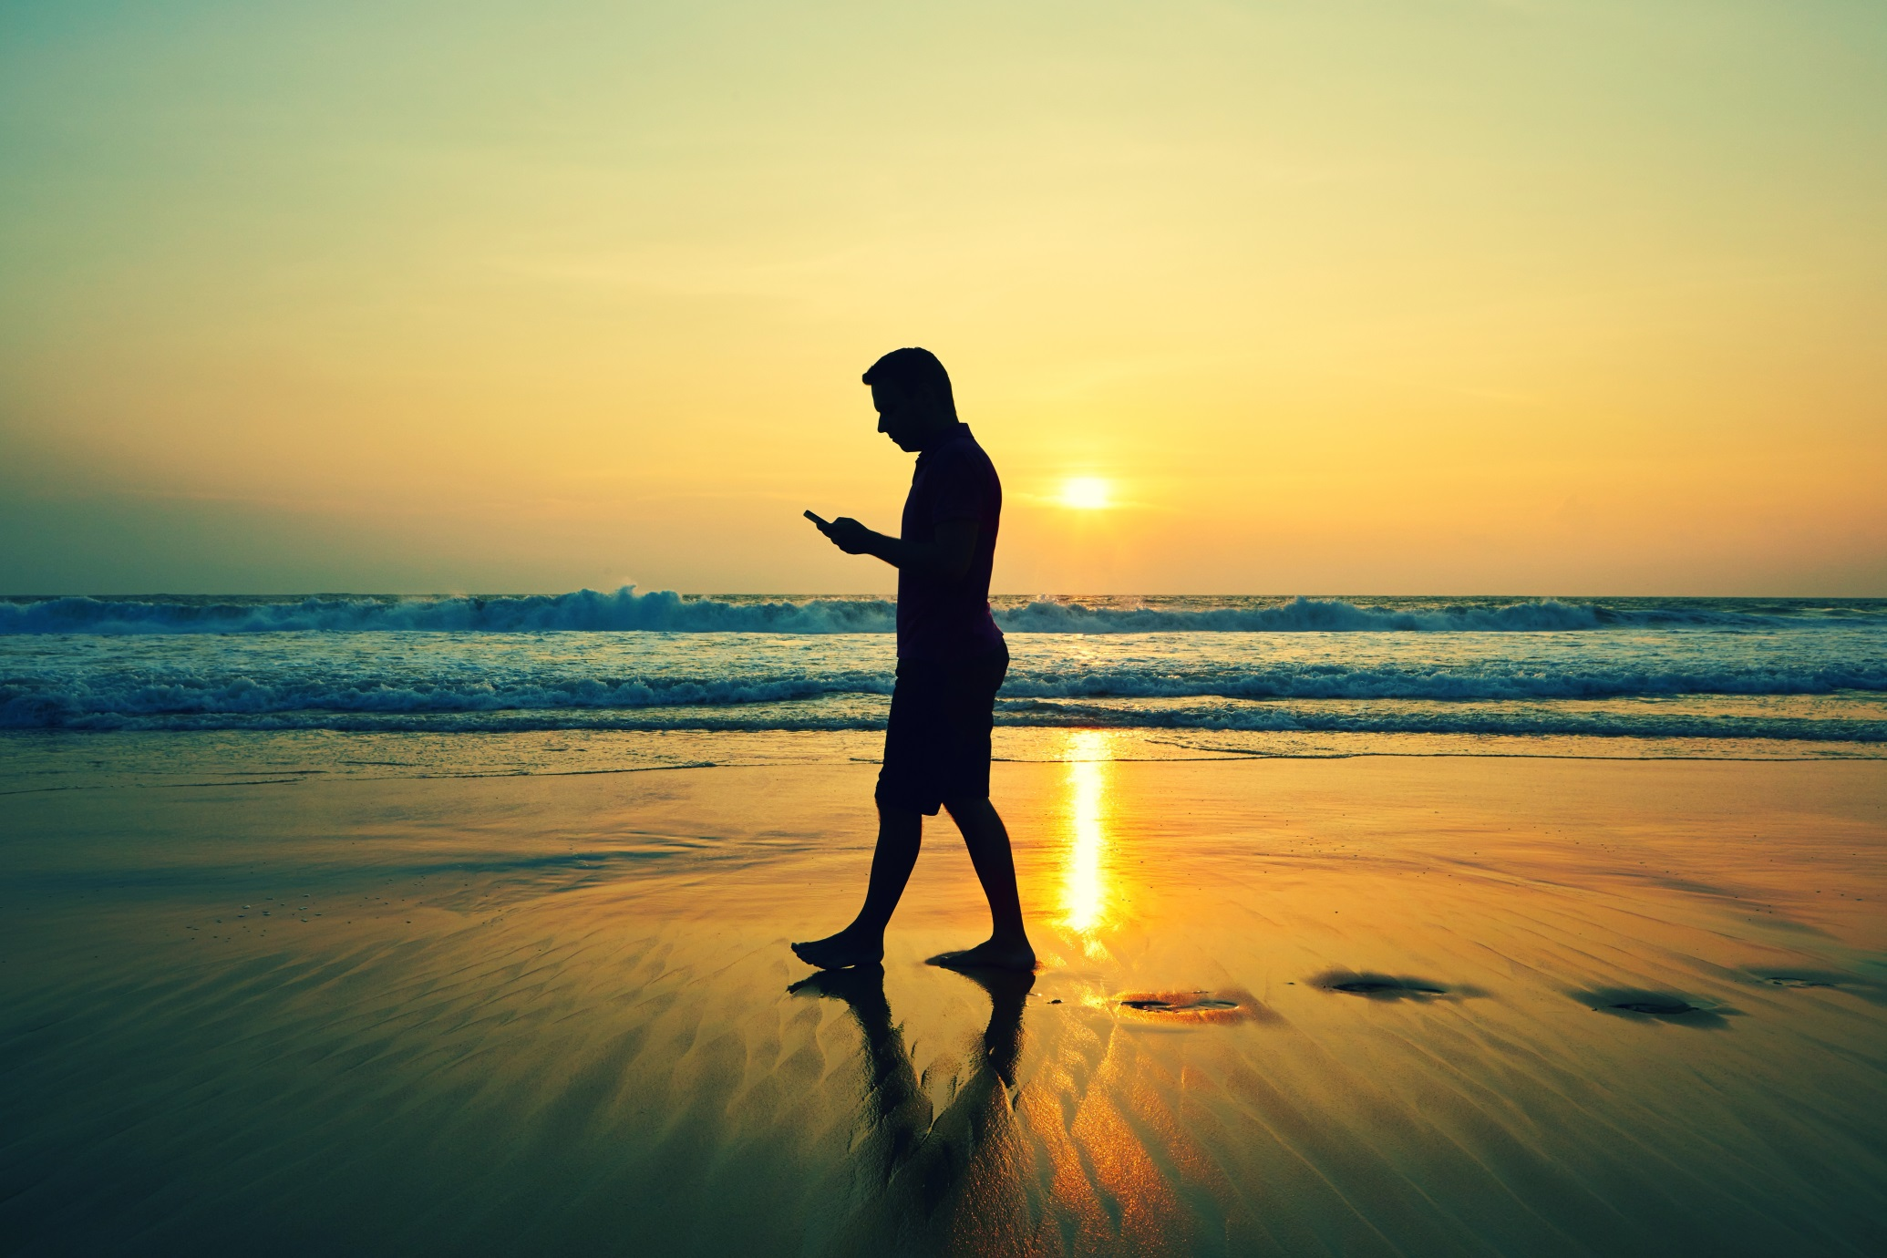
Conversion can happen anywhere
Notes:
The linear path to purchase is being eroded, there are now many different points at which a customer may convert to purchase.
There are many examples – from the amazon dash button, to buy buttons in social, that are helping brands to seamlessly convert people to customers.

Slide 22
Social is the next service channel
80
Relationship strength
53
Received a response
Did not receive a response
Source: Connected Life
Source: Connected Life 2015 - Banking
Notes:
Not responding quickly impacts the relationship, so it is critical you’re going where the consumer wants to be.

Slide 23
Four opportunities to focus on instead
New ways to
segment
New ways to target consumers
New touchpoint priorities
New way to target moments
Notes:
The more we de-average our approach to marketing, the more we can achieve. We’ll spend the rest of today discussing four distinct areas of opportunity that only exist because we’re able to take advantage of new consumer behaviours, and the diversity that now exists in the market
[Link topic to rest of agenda using this slide]
‘We’ll cover more on how to market to these groups in the marketing in a connected world session. We’ll look at new business models that only exist because a portion of a de-averaged market has decided to buy their razorblades online’ etc

Slide 24
Device use is constant throughout the day
Reach of devices and media throughout the day – Norway
%
Source: Connected Life

Slide 25

Brand equity is not
10
8
6
Situational Equity
4
2
0
Early morning
(6am-9am)
Midday
(12am – 2pm)
Mid afternoon
(7pm – 9pm)
Evening
(7pm – 9pm)
Late night
(After 11pm)
8
Notes:
For Starbucks, as you’d expect from a coffee brand, there equity peaks in the morning, when most people need a caffeine hit, and just after lunch

Slide 26
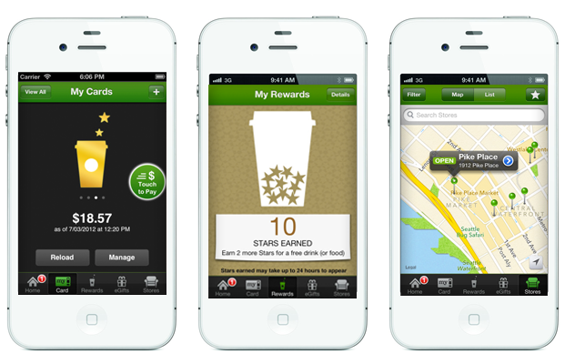
Starbucks already know this
9
Notes:
Starbucks know this and have responded with a number of propositions that are linked to the motivations of their consumers first thing in the morning

Slide 27
Four opportunities to focus on instead
New ways to
segment
New ways to target consumers
New touchpoint priorities
New way to target moments
De-average your consumer
Understand their mindset
Identify the right touchpoints
Align them against brand moments
Notes:
The more we de-average our approach to marketing, the more we can achieve. We’ll spend the rest of today discussing four distinct areas of opportunity that only exist because we’re able to take advantage of new consumer behaviours, and the diversity that now exists in the market
[Link topic to rest of agenda using this slide]
‘We’ll cover more on how to market to these groups in the marketing in a connected world session. We’ll look at new business models that only exist because a portion of a de-averaged market has decided to buy their razorblades online’ etc

Slide 28
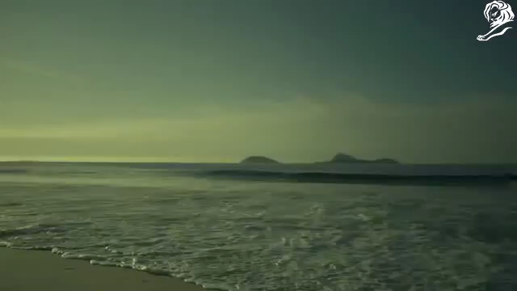
Just one example from Nivea in Brazil
Notes:
https://www.youtube.com/watch?v=nZ532wkhHYs
Nivea:
Nivea launched two separate campaigns to reach two groups of beachgoers- young mothers and the mobile-centric millennials
For young mothers, Nivea gave out a GPS tracked bracelet that was detachable from a magazine ad. Parents can then download the Nivea app, link the band and receive alerts on where their kids are on the beach.
For beachgoers who are constantly on their phones, Nivea created a print ad on a magazine that doubles as a cellphone charger, allowing beachgoers to use solar energy to recharge their phone.

