Slide 1

Consumer and Media
(Norwegian TGI)
Norway's largest survey for insight about peoples media and consumption habits
Content and structure
September 2020

Slide 2

Consumer & Media
The Norwegian Target Group Index (TGI)
Norway’s largest survey about peoples media usage and consumption habits
Do you want to understand the media- and consumption patterns of your target group? Or maybe you want to know what is the profile of your current customers? Or maybe you want to know which media are most relevant in order to reach consumers that consider brand as one of the alternatives to buy?
Consumer & Media, (the Norwegian TGI*), is Norway’s largest survey and data is collected continuously through the year. It gives you the possibility to compare different individual media towards each other, and to compare media usage directly with the consumers’ lifestyle, consumption habits, brand preference, purchasing plans, decision responsibilities at work, demographics and geographic. It is an important tool for media- and creative agencies, brand owners and governmental authorities for market and target group insights, and for selecting media in an advertising campaign.
Data are presented in a software and you can have access to usage of the data through subscription, or we can tailor a report based on your current needs.
About Consumer & Media
Established in 1988. Continuous updating of content to prevail relevance for insight deep dives.
45 000 yearly interviews.
Measures approx. 960 individual media brands/titles.
Measures brand awareness and preference for approx. 1.900. brands across 175 categories.
Measuring 120 attitude statements, 90 interests and 40 activities.
*TGI = Target Group Index and an asset of Kantar

Slide 3
Consumer and Media (C&M) / Target Group Index (TGI)
Norway’s largest consumer & multimedia study
The C&M study contains two parts
C&M CATI Survey
– Gathers data from 45.000 respondents on media usage as well as holding demographic information. The study includes official usage data for newspapers, radio, internet, TV and cinema.
C&M TGI
– Approx. 15.000 CATI respondents also complete some but not all sections of a TGI questionnaire. All 15.000 complete a general section which includes questions relating to media usage (e.g. magazines), supplementary demographic information, attitudes and lifestyle.
Media usage: newspapers, radio, internet, TV, cinema
Background demographics: age, sex, nationality, household/personal income, household size, geography, education
No. of respondents
45.000
CATI
Survey
Media usage
Interests and activities
Attitudes and opinions
Consumption and spend
Ownership and purchase intentions
Brands: Durables, FMCG and services
Awareness, preference, use most often or own today
Professional role and business decision making
Shopping centers and local stores
Segmentation tools
30.000
15.000
TGI
(Self completion Cawi or paper)
No. of variables

Slide 4
TGI content and sampling procedure (1)
CATI / Recruitment interview
Demography, geography and media usage
General and Common part:
Interests and activities, attitudes and opinions, editorial content, streaming and digital behavior, work status, family background, spending in categories, shopping habits and purchase decisions, shopping centers
PART 1
Fmcg and other non-capital goods
Category information:
Consumption, food & beverages, cosmetics, cleaning and toiletries, clothes, shoes, paint, grocery and convenience stores, gas stations, shopping centers, retail stores visits, etc.
PART 2
Durables
Category information:
Ownership and purchase intentions, electronics, telecommunication, computer, mobile phones, bank & insurance, tourism/travel/leisure, furniture, building materials, interior materials, garden/flowers, children toys and equipment, cars, charity, lottery/gaming, retail stores visits, etc.
BRANDS
– fmcg and other non-capital goods
(Brand Awareness, Brand Preference, Brand Use most often)
Food and beverage, household products, personal care, clothing and shoes,
stores and retail chains, etc.
BRANDS
– durables and services
(Brand Awareness, Brand choice, Brand ownership)
Cars, white goods, telephone companies, mobile phones, real estate agents, bank/insurance, credit cards, restaurants, hotels, tourism, transportation, media, energy, health and training, stores and retail chains, etc

Slide 5

MEDIA INDEXES:
Newspapers | The official readership figures for newspapers including both paper and digital readership.
Magazines | The official readership figures for magazines including both paper and digital readership.
TV | Access and daily viewing of TV in total and individual channels. Including Heavy-Medium-Light viewing groups. (incl. Cinema!)
Radio | Access and daily listening to Radio in total and individual channels. Including Heavy-Medium-Light listener grouping.
Internet | Access and daily usage of Internet in total and loyalty of usage of individual sites. Including Heavy-Medium-Light user groups.
MARKET AND CONSUMER INDEXES:
Lifestyle | Statements that describes peoples attitudes, opinions and outlook on life as well as their interests and activities they take part in. This section is the main foundation for the different segmentation models that are developed.
Consumption | Questions about peoples consumption patterns, spending on different products and services, and shopping habits. In this section we have included Opinion Leadership and Word of Mouth categorizations.
Durables | Ownership and purchase intentions of different types for durables/capital goods and services. Travel, holiday, banking, insurance also folds into this index.
Brands | Awareness, preference and usage of a variety of different brands within different product categories across fmcg, services and durables. The information is presented in different graphical tools
Work and decision making | Information about occupation and professional life. Business sector/industry, company size, title and position, decision-making responsibility and/or influence in different product categories.
Regional | Awareness, preference and usage of local shopping centers in different areas of Norway.
Editorial | Information about interests in different content categories in media in general and in specific media channels. Online surf and search behavior.
Sosioraster | Segmentation based on sociology and the theories of the French sociologist Pierre Bourdieu where family background and upbringing are important factors.
Kompass | Lifestyle segmentation model based on attitudes, activities and interests
LifeValues | Kantar TGI global segmentation model based on 32 standardized attitude statements on different subjects.
OCEAN | Kantar TGI model of calculating the “The Big Five” personality traits (Openness, Conscientiousness, Extroversion, Agreeableness, Neuroticism)
Mosaic | Moasic is a sosiogeographic segmentation model with global presence. 13 Mosaic segments and the 44 underlaying Mosaic types are available for analysis and insight in C&M.

Slide 6

Key facts Consumer & Media Study
Norwegian TGI
Consumer & Media survey at a glance:
In Consumer & Media (Forbruker & Media) we have approx. 5.800 variables in the TGI part of the survey and 2.500 in the CATI part, There is a single source recruitment from the CATI to the TGI (web/postal) part of the study.
Overall we have approx. 8.300 variables altogether per respondent.
Categories and Brands:
173 Categories
  (36 shop/retail categories, 29 categories of services, 108 product categories)
1.897 Brands
  (293 shops, 311 services companies, 1.293 product brands)
Lifestyle: Attitudes, interests and activities
Attitude statements: 120
Interests: 92
Activities/doings: 40

Slide 7
2.
Segmentation and market models within Consumer & Media (TGI Norway)

Slide 8
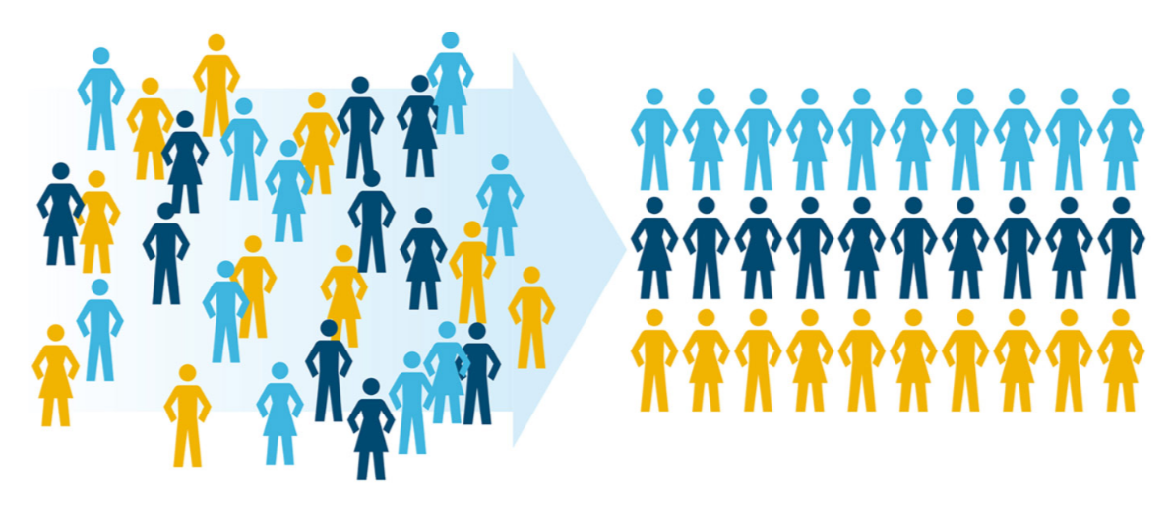
Segmentation models within TGI Norway
Different segmentation solutions
The software Gallup PC contains all the C&M data, including different segmentation tools for analysis purposes.
The different segmentation solutions are
Compass
Life Values (Kantar global modell)
Sosioraster
Connected Life (Kantar global model)
Word Of Mount index (WOM)
Early Adopters
Media Consumption Index (H, M, L)
Generations
Mosaic
OCEAN (Kantar global model)
Applications: Identify and describe target groups, communication strategies and media planning

Slide 9
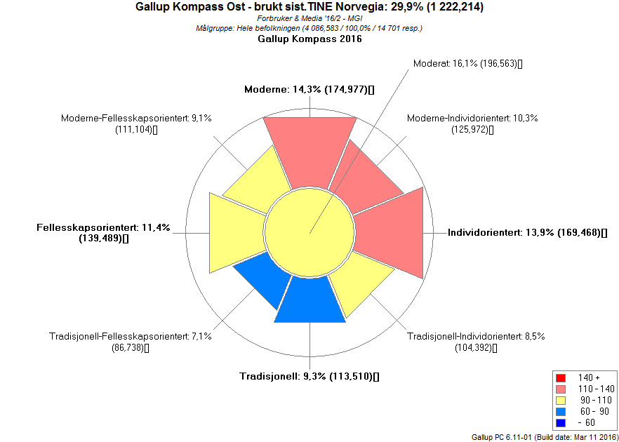
1. Compass
Lifestyle segmentation based on attitudes, interests and activities
Segmentation methodology
The segmentation tool is based on the idea that the personal attitudes and actions of individuals in a society will follow given patterns.
The two main dimensions in the Compass:
Dimension 1: Community – Individuality
Dimension 2: Modern – Traditional
In Compass the population are divided into 9 segments.
The method being used to create the two dimensions, and consequently the 9 segments, is Principal Component Analysis (PCA), base on different subjective variables:
Interests and activities: sport, culture, music, technology and media.
Opinions and attitudes towards different subjects: risk and regularity, environmental and economical issues, shopping and consumption habits, level of solidarity and cultural and economic liberalism in the society.
Two main dimensions and 9 segments
Example on graphical output
Usage of cheese brand “TINE Norvegia”
  Red: high indexed segments
  Blue: Low indexed segments
Modern
8
1
2
Distribution of the population
Community
oriented
7
9
3
Individually
oriented
6
5
4
Traditional

Slide 10
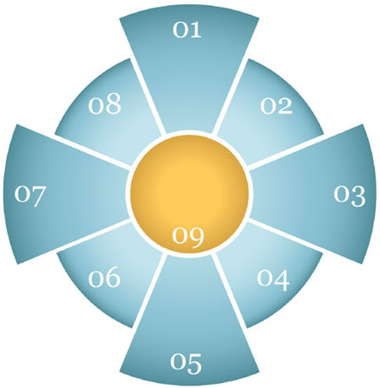
Compass
01 Modern (12 %)
Male 20-49 yrs. Old (the youngest segment)
Education: Many students
Income: Low or high (students low)
Interested in popular music, shopping, electronics, movies & series. Like trying new things, follows fashion trends, brand conscious. Thrill seekers, like challenges. Active online (social media, looking for brands/services, search),
Activities: video gaming, team sports, jogging, watching sports on TV, outgoing (nightclubs/bars).
08 Modern –Community Oriented (9 %)
Male 20-49 yrs. old
Education: High
Income: Low to medium (students low)
Environmentally conscious and
socially engaged, trendsetter, fashion interested. Quality-conscious consumers. Internet is an important news source.
Activities: festivals/concerts, opera/theater, library, art exhibitions and museums, going out (nightclubs/bars), climbing, running, team sports.
02 Modern – Individually Oriented (9 %)
Male 20-49 yrs. old
Education: Many students
Income: Low or high (students low)
Thrill seekers. pro privatization and market-economic management in the society, brand conscious, like to try new things before others. Politically right wing. Concerned about their careers. Interested in technology, fashion, shopping, gaming and cars.
Activities: Active in sports both as spectators and participants. Often go to the pub/bar/nightclub.
Segment description
09 Moderate (16 %)
40-49 yrs. old
Education: Medium to high
Income: Medium to high
Mainstream.
Medium socially engaged. Interested in work, home and family.
Activities: golf, hunting, fishing, cross country skiing and general exercise / training.
07 Community oriented (12 %)
Women 40-59 yrs. old
Education: High
Income: Medium to high
Community engaged, interested in culture, quality and environmentally conscious. Focus on organic food, good ingredients and a healthy diet, likes food from different parts of the
world. Listens to classical music, jazz and folk music.
Activities: cultural venues, religious events, hiking, cross-country skiing.
03 Individually Oriented (12 %)
Male 30-49 yrs. old
Education: Low
Income: Medium to high
Materialistic, like new technology, pro privatization and market-economic management in the society. Not very interested in fashion and culture. Price conscious.
Activities: Hunting and fishing, watching sports on TV, not very interested in physical exercise.
06 Traditional – Community Oriented (9 %)
Women 60-79 yrs. old
Education: High
Income: Low to medium
Tradition, moral, safety seekers, cautious consumers, many religious, fond of Norwegian products, environmentally conscious, engaged in family and health. Generally interested in culture. Newspapers (local and national), radio and television. Listens to opera, jazz and ‘danseband’.
Activities: go to the theater, museums, library, opera and art exhibitions, religious events. Not very interested in physical exercise.
04 Traditional - Individually Oriented (9 %)
50-79 yrs. old
Education: Low
Income: Low
Price conscious. pro privatization and reduction of social security and foreign aid, like well-known brands. Seeks safety and like routines. Listen
the ‘danseband’ music, country and roots. Politically right+ wing. Traditional media dominates.
Activities: Hunting and fishing, but not very interested in physical exercise.
05 Traditional (12 %)
Women 60-79 yrs. Old (the oldest segment)
Education: Low
Income: Low (many pensioners)
Tradition, safety seekers, like regularity and order. Loyal customers. Cost and quality conscious consumers. Interested in gardening, sports on TV and enjoy folk music and ’danseband’ music. Traditional media use, newspapers very important, reading magazines.
Activities: Fishing, walks, hiking, religious events.

Slide 11
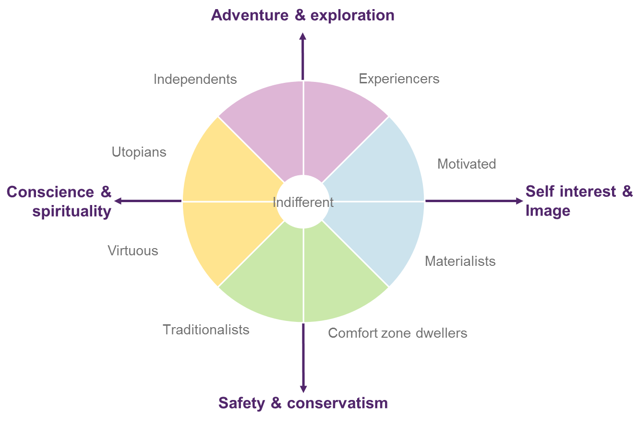
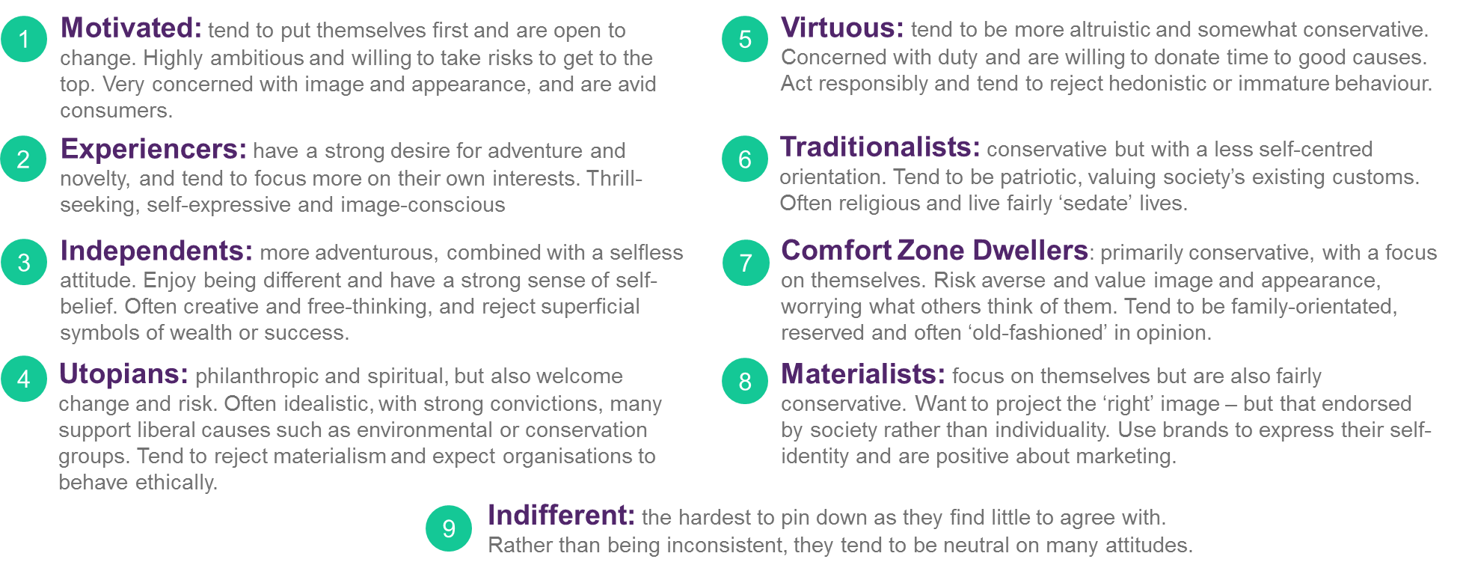
2. Life Values segmentation
Lifestyle segmentation based on the transcultural
Schwartz Theory of Basic Human Values
The model and it’s segments
Summary overview of the segments

Slide 12

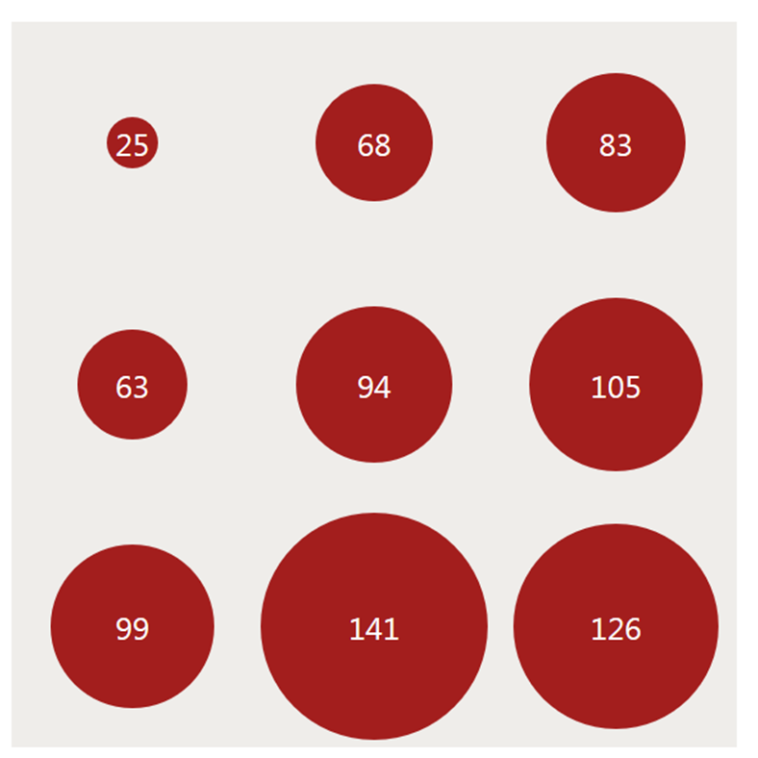
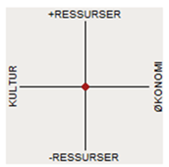
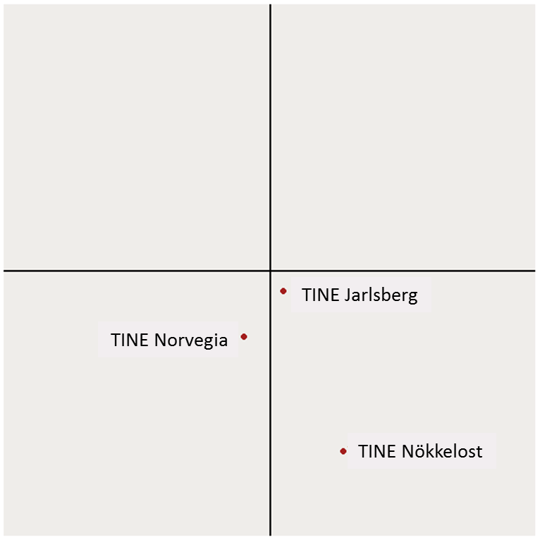
3. Sosioraster
Segmentation based on sociology
Segmentation methodology
The segmentation tool is based on the French cultural sociologist Pierre Bourdieu's study and his book La Distinction..
The two main dimensions in the Sosioraster:
Dimension 1: Cultural capital – Economic capital
Dimension 2: Low volume – High volume
In Sosioraster the population are divided into 9
segments (social fields with homogeneous groups )
based on their economic and cultural capital.
Multiple Correspondence Analysis (MCA) is used to create the two dimensions, and consequently the 9 segments, from objective background variables:
total value of car(s)/boat(s)/house(s)/secondary home(s) and other assets, household income, heritage cultural capital (grew up in a home with encyclopedia/ piano/ foreign books/chess), level of education, subject areas education, private/public school, occupation, occupation private/public sector, level of education and occupation of parents).
Two main dimensions and 9 segments
Example on graphical output
Preference to cheese brand “TINE Nökkelost”
  Segment size and index value
High volume
8
1
2
Distribution of the population
Cultural
capital
7
9
3
Economical
capital
6
5
4
  Position of Brand and main competitors
Low volume

Slide 13
Sosioraster
High volume
Male 20-49 yrs. old
Education: High
Income: High
Politics: Labor and Right
Gallup Compass: Modern and/or Community oriented.
Work: private sector, administrative/HR, consulting, IT, research.
High volume - Culture
Women 20-39 yrs. old
Education: High
Income: Low
Politics: Labor, highest share of voters for Green Party
Gallup Compass: Modern – Community oriented.
Highest cultural capital
Subject areas – higher education: medicine, law, science, philosophy, history. Work: public sector, education, research.
Highest share of students.
High volume - Economy
Male 40-59 yrs. old
Education: High
Income: High
Politics: Right
Gallup Compass: Modern and/or Individually Oriented
High cultural capital
Subject areas – higher education: economy, technical. Work: private sector, IT, economy. Highest share of managers/CEO’s.
Segment description
High volume, Cult.
(9 %)
High volume
(12 %)
High volume, Econ.
(9 %)
Culture
Women 20-49 yrs. old
Education: Medium to high
Income: Low
Politics: Labor, highest share of voters for Red Alliance.
Gallup Compass: Modern and/or Community oriented.
High cultural capital
Subject areas – higher education: health care, society. Work: public sector, health care, education.
Economy
Male 40-69 yrs. old
Education: Medium to high
Income: High
Politics: Labor, Right
Gallup Compass: Individually Oriented.
The segment with the highest share of men. Subject areas – higher education: economy, technical. Work: private sector, economy. High share of managers/CEO’s.
Moderate
20-49 yrs. old
Education: Medium to high
Income: Medium to high
Politics: Labor
Gallup Compass: Evenly distributed among the segments, but with lower shares within the Traditional segments.
Mainstream.
Moderate
(16 %)
Culture
(12 %)
Economy (12 %)
Low volume, Cult.
(9 %)
Low volume
(12 %)
Low volume, Econ.
(9 %)
Low volume - Culture
Women 40-69 yrs. old
Education: Low to medium
Income: Low
Politics: Labor
Gallup Compass: Evenly distributed among the segments, but with lower shares within the Modern segments.
The segment with the highest share of women. Subject areas – higher education: health care. Work: public sector, health care. High share of pensioners.
Low volume - Economny
Male 50-69 yrs. old
Education: Low to medium
Income: Medium to high
Politics: Labor, highest share of voters for Right++
Gallup Compass: Traditional or Individually oriented
Lowest cultural capital
High share of persons with secondary school as their highest education level.
Work: private sector, production, logistics, crafts. High share of pensioners.
Low volume
40-69 yrs. old
Education: Low to medium
Income: Medium to high
Politics: Labor
Gallup Compass: Traditional or Individually oriented
Low cultural capital
High share of persons with secondary school as their highest education level.
Work: private sector, production, logistics, crafts. Highest share of pensioners.

Slide 14
4. Connected Life
Segmentation based on digital influence and social media engagement
Background and methodology
Connected Life segmentation classifies the population into five segments based on their level of digital influence and engagement in social media. The model stems from Kantars Connected Life study and has being recreated using existing variables within Consumer & Media
The two dimensions in Connected Life are::
Dimension 1: Low to high digital influence
Dimension 2: Low to high social engagement
Principal Component Analysis (PCA) are used to create the two dimensions, and consequently the five segments, from variables measuring digital media usage and social media engagement:
Freq. of use: internet, social media, internet through smart phone/tablet and streaming services. Where to access internet: home/work/school/other places. Freq. of downloading music/films/series, looking for and reading reviews on products/services online, reading/writing blogs, participate in chatting/
discussions, comment/share/like/retweet.
Two main dimensions and five segments*
Description of the five segments
SUPER LEADERS
Within the leader segment – the most active and most social group of all. Likely to be the earliest of adopters, the influencers and the trend setters.
High
SUPER LEADERS
(10%)
LEADERS
The most digitally, and socially active of all the segments. They may be online as much as the Observers, but they are highly social, creating and sharing content, and engaging with brands.
OBSERVERS
(19%)
LEADERS
(22%)
DIGITAL INFLUENCE
CONNECTORS
Spend a limited time online, but when they are,
they are heavily social.
FUNCTIONALS
Spend the least time online – either through choice, or lack of access. Will often use online where there is a tangible advantage, but are the slowest to adopt new trends. They are the least social of all the groups.
FUNCTIONALS
(29%)
CONNECTORS
(20%)
Low
OBSERVERS
Spend a lot of time online, but are less open to engaging with brands in a social space.
Low
SOCIAL ENGAGEMENT
High
Global Kantar model
*segment sizes and descriptions as for Norway in The Connected Life Study 2017/2018

Slide 15
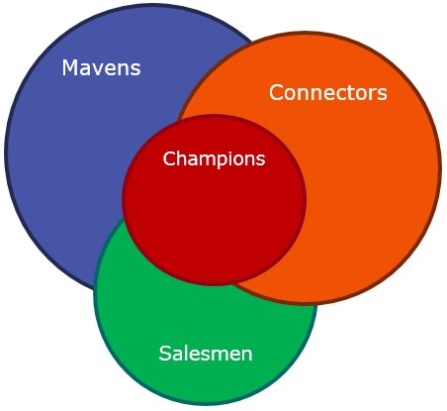
5. Word of Mouth and Opinion Leadership
Classification of consumers in different product groups according to their knowledge, persuasiveness and interaction with others
Background and Methodology
The WOM index maps out opinion leaders within specific categories. Opinions leaders are people who have an ability and a willingness to spread messages and influence other people's behaviors through their views and advice. The models background can be found in two-step flow of communication model that says most people form their opinions under the influence of opinion leaders, who in turn are influenced by the mass media (Paul Lazarsfeld et al. 1944).
Based on questions about social skills, innovation willingness and interest in new products, TOGETHER with questions about how updated or interested a respondent are in different categories, we are able to define three segments for each category; Connectors, Salesmen and Mavens. (ref. Malcolm Gladwell, The Tipping Point, 2000). The ones who classifies into all segments are defined as Champions (Opinion Leaders).
The different WOM segments can help “amplify” an advertising campaign and/or product launch significantly through f2f communication or social media. In today’s digital world this can happen much faster than before because of social media.
Four segments and 12 product categories
Description of the segments
CONNECTORS
Connectors are super social and ”talk” to many about their areas of interest. With a large network and a social competence they are a good starting point for a campaign.
SALESMEN
A Salesman is a person with a strong knack for persuasion
in the category. Salesman are individuals who like to persuade their environment of products pros and cons. They are likely to convince others about their opinions.
MAVENS
Mavens has the deepest knowledge in the category and who could give a large amount of information about a product. They search for information and are happy to share of their superior knowledge. They are helpful and a good source if you need good advice.
The segmentation is done in these specific categories:
Food and beverage Economy
Health, Cosmetics Electronics
Clothing & shoes Politics and society
Leisure and Travel Cosmetics
Automotive TV, Radio & music equipment
Interior, house and home Occupation / Profession
CHAMPIONS
These are people who falls into all the above-mentioned segments. Hence, they are a group that talk
to many different people, could give a large amount of information, and are likely to convince others about their opinions.

Slide 16
6. Diffusion and Adopters
Categorization of consumers based on innovativeness
Background
In addition to the Word of Mouth segmentation we have made a general innovation model to identify different categories of adopters.
The model is constructed from questions about how often the respondents search for information about new products and services, look out for new things and their willingness to try things before their friends.
The model divides the population into five different Adoption Groups with predefined sizes given from the “Diffusions of Innovations” theory:
Innovators (3 %)
Early Adopters (13 %)
Early Majority (34 %)
Late Majority (34 %)
Laggards (16 %)
Adoption Curve
Derived from “Diffusions of Innovations”, Everett Rodgers, 1962.
According to this established theory, the criterion for the adopter categorization is innovativeness, defined as the degree to which an individual adopts a new idea.
Diffusion and adoption theory
Diffusion of innovations is a theory that seeks to explain how, why, and at what rate new ideas and technology spread. Everett Rogers, a professor of communication studies, popularized the theory in his book Diffusion of Innovations; the book was first published in 1962.
Rogers argues that diffusion is the process by which an innovation is communicated over time among the participants in a social system.
Rogers proposes that four main elements influence the spread of a new idea: the innovation itself, communication channels, time, and a social system.
This process relies heavily on human capital. The innovation must be widely adopted in order to self-sustain. Within the rate of adoption, there is a point at which an innovation reaches critical mass.
Source: Wikipedia
Early
Majority
(34 %)
Late
Majority
(34 %)
No./%
Early
Adopters
(13 %)
Laggards
(16 %)
Innovators
(3 %)
Time

Slide 17
7. Media Consumption
A topline view of media consumption
Background and media measurement
There are many different media titles being measured in Consumer & Media for all media channels
TV, radio, newspapers, online newspapers, magazines, web magazines, other online sites, streaming services, social media, direct mail, outdoor, cinema and more
The individual media brands we measure spans from national through regional to local.
Most media we measure are computed for media planning/scheduling purposes – down to specific titles. For analytical purposes and target group insights we have constructed two types of aggregated media indexes; 1) Daily reach, and 2) Heavy-Medium-Light usage.
Both can be used for better understanding of a target group’s use of different media channels in addition to other characteristics.
Daily reach
Heavy – Medium – Light users
Categorization of users of a media channel into three approximate equally split groups
Based on media usage questions we seek to allocate users into three equally split groups; 1/3 light, 1/3 medium and 1/3 heavy users
Media consumption comparison | Total population (%) |  |  | Age 15-29 Affinity Index
 | Low | Medium | High | Low | Medium | High
TV | 32 | 33 | 36 | 205 | 76 | 28
Radio | 32 | 33 | 35 | 172 | 89 | 45
Newspaper | 32 | 33 | 35 | 160 | 99 | 47
Magazines | 31 | 34 | 35 | 171 | 88 | 48
Internet | 33 | 32 | 35 | 47 | 120 | 131
Streaming | 36 | 33 | 30 | 14 | 99 | 204
Cinema | 31 | 37 | 32 | 34 | 109 | 155

Slide 18
3.
Marketing models within Consumer & Media (TGI Norway)

Slide 19
Marketing models within TGI Norway
Different solutions for market overview, identifying market challenges and classification of consumers
The software Galileo contains all the C&M data, including different market insight tools for analysis purposes.
The different marketing models are:
Market Map
Communication Map
Push Pull
Applications:
Identify and describe target groups,
develop communication strategies and
perform media planning.

Slide 20
Market map
Identifies the unsolved communication tasks for a brand (fmcg and other short-term goods)
The Market Map divides consumers of fmcg, short term goods and shops into groups based on their awareness and experience with a particular brand. The model was an invention by the Norwegian Otto Ottesen in 1977 who then worked as a professor at Copenhagen Business School.
The map builds on the simple assumption that a brand needs to be known to consumers, tried and a preferred choice for customers to become loyal. Brand awareness and rial are the starting points. Then it is central to know how consumers perceive the brand. The map helps marketeers to detect which areas to focus on to stimulate brand growth.
Input variables for The Market Map:
Brand Awareness
Trial
Evaluation (preference, indifferent or rejection)
BRAND: Oatly (milk oatdrink)
44% Aware
56% Unaware
2% - Preference
10% - Indifferent
20%- Have tried
8% - Rejects
24% - not tried
Trial share: 46%
Share preference: 12%
Share indifferent: 50%
Share rejection: 39%

Slide 21
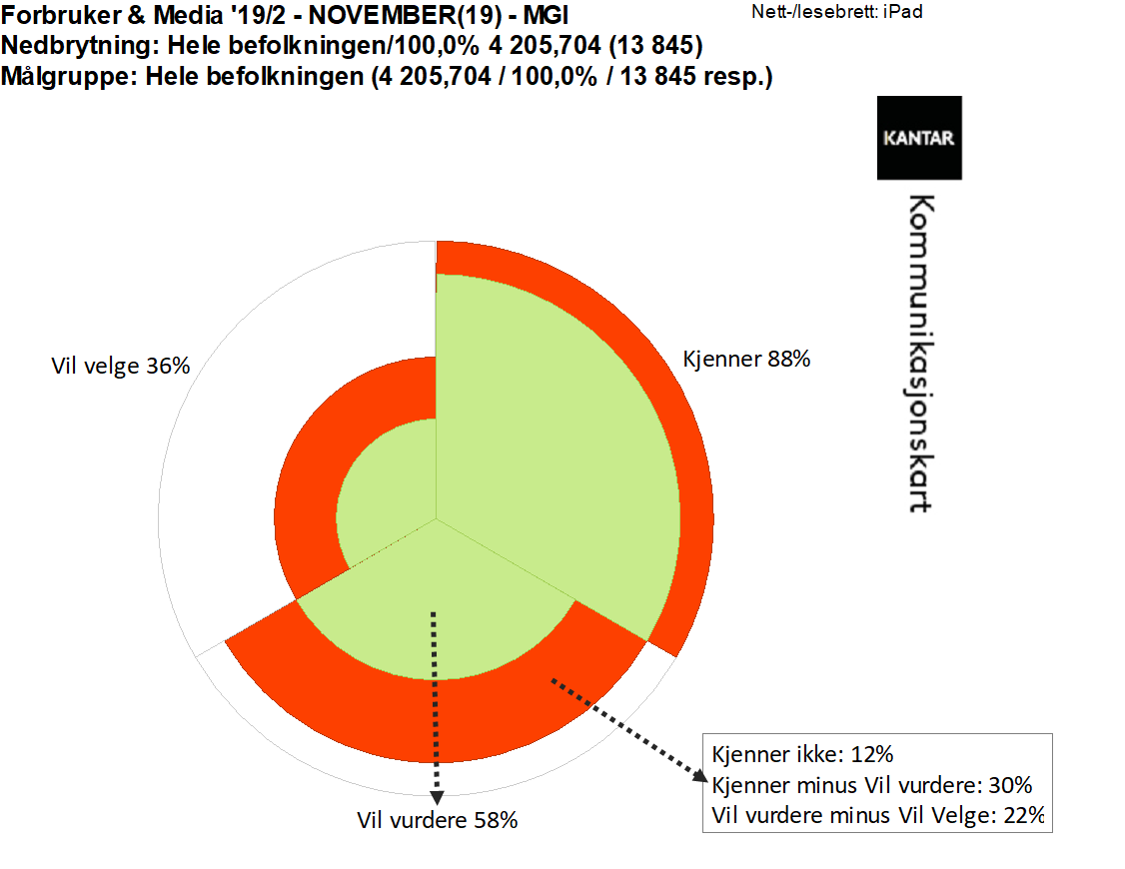
Communication map
Identifies the unsolved communication tasks for a brand (durables/capital goods)
The Communication Map divides consumers of durables and capital goods into groups based on their awareness and evaluation of a particular brand.
For durables we usually do not see repetitive repurchase. A consumers own experience are therefore quite limited. Information about brand consciousness and if it is part of a consumers evoked set are of vital importance for a marketeer. It is vital for a marketeer to have a clear picture of this context in order to put in place an effective communication strategy.
The model breaks down the path to purchase from brand awareness, via brand consideration, to purchase intention. The input variables for The Market Map are:
Brand Awareness
Evoked set (consideration set)
Will choose (purchase intention)
BRAND: iPAD
Will Choose 36%
Awareness 88%
Unaware: 12%
Aware – Evoked set: 30%
Evoked Set – Will Choose: 22%
Evoked Set 58%
(will consider)

Slide 22
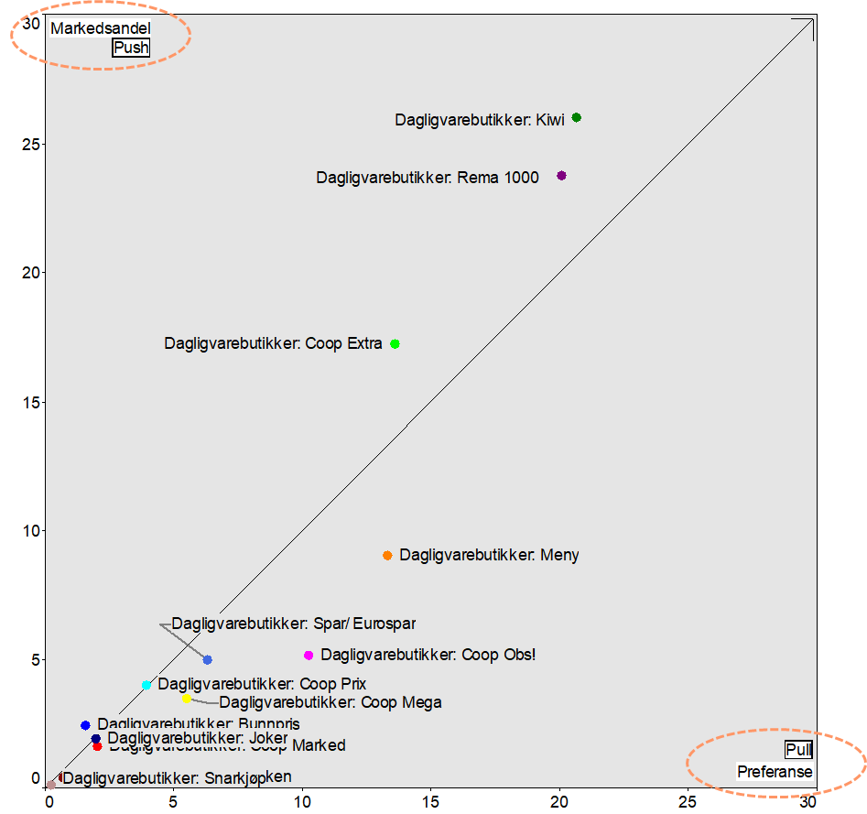
Push/Pull
Looks at the relation between market share vs. purchase intention or brand preference
GROCERY CHAINS/STORES
The Push/Pull analysis puts the attention towards the distance between purchase intention or brand preference and the market share of different brands in a category. Hence we can also see the relative position for brands in a product category.
In TGI the purchase intention or brand preference represent the PULL axis of the graphic. Market share (measured as «brand last bought» or «brand use most often») represents the PUSH axis.
Push position: A brand positioned above the 45-degree diagonal line has a market share that is not reflected in the underlying purchase intention or brand preference. A typical price leader will have such a position. The position can be vulnerable IF a brand is challenged on it’s price and/or distribution advantage.
Pull position: A brand positioned below the 45-degree diagonal line has a purchase intention or brand preference that is higher than the acquired market share. Typically this is the position for premium brands that often are able to charge a higher price than other brands.
Market share
PULL
PUSH
preference

Slide 23


About Kantar
Our mission is to make our clients smarter. We believe that well-thought out and fact-based decisions win over decisions made by pure gut feeling. That’s why we have studied the Norwegian market since 1946, and helped our clients make well-informed decisions, based on what really happens in their market.
Kantar is the world’s leading evidence-based insights and consulting company. We have a complete, unique and rounded understanding of how people think, feel and act; globally and locally in over 90 markets. By combining the deep expertise of our people, our data resources and benchmarks, our innovative analytics and technology, we help our clients understand people and inspire growth.
In total we are over 30.000 engaged employees worldwide, where 120 are based in Norway. In Norway our fieldwork organization of Norsk Gallup Institutt AS are a 100% owned subsidiary of Kantar.

Slide 24
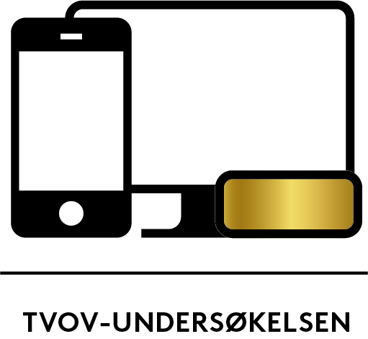
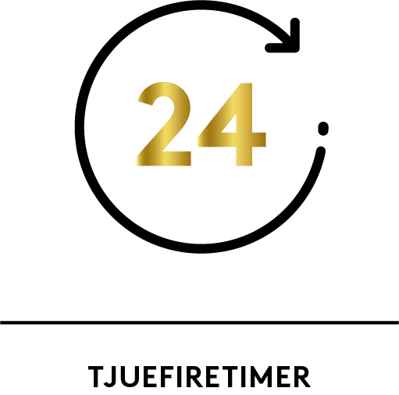


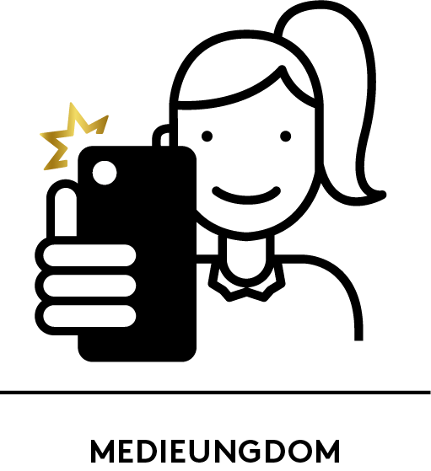



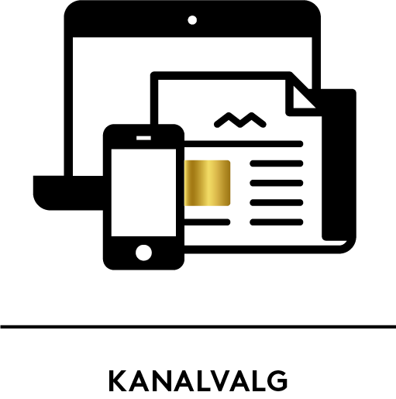

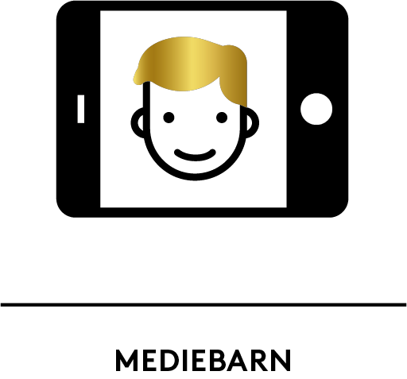
Syndicated media surveys from Kantar
Norway
CONSUMER & MEDIA
TVOV MEASUREMENT
(TV CURRENCY)
24 – THE MEDIA DIARY
INTERBUS
(Digital trends TGI)
SOCIAL MEDIA TRACKER
MEDIA YOUTH
NEWSPAPER READERSHIP (NRS)
MAGAZINE READERSHIP (NRS)
PROFESSIONAL PRESS
FUNCTIONALITY OF MEDIA
AND CHANNEL USAGE
HOUSEHOLDS MEDIA
COSTS
MEDIA CHILDREN

Slide 25


