Slide 1
The worlds first FM switch off:
What happens to the listening?
Bodø 11.01.17
Knut-Arne Futsæter Kantar TNS
@Futsaeter

Slide 2
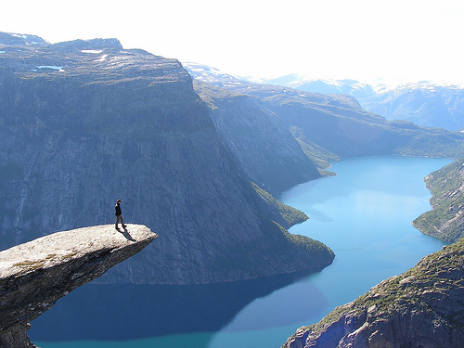
#LookToNorway: Digital leader
Internet 96%
Broadband 86%
Smart phone 89%
Tablets 70%
Access
Internet 88%
Facebook 71%
Mobile content 63%
Daily
reach
Notes:
Kilder: F&M, brebånd=Tvtracker, Face=IB

Slide 3

TV, newspaper and magazines are declining
20 years with stability for radio
Percent
TV Cassette Walkman Com.TV CD mp3 Spotify Podcast
Source: Daily reach 1961-2015. Figures from Consumer & Media from 1994.
Flerkanalsamfunnet (Lundby & Futsæter, 1993)
fragmentering av medielandskapet og oppsplitting av publikum (Futsæter 1998).

Slide 4
Internationalization & fragmentation
Consumption of Norwegian editorial content for TV, newspaper and magazines is declining
Internationalization of the media content
More devices, more media, more content, more User Created Content (UCC)
→ fragmentation of the media use → smaller audiences
Different devices and media content satisfies different needs on different time, places and in different situations
International companies like Facebook, YouTube and Netflix are for the first time challenging the Norwegian media industry and are changing the usage patterns
The Norwegian language, identity and culture is being challenged
Common spaces for experiences, entertainment, public discussions are under pressure
Radio

Slide 5
Daily viewing time for TV 1983 -2015:
Peaks in 2009 when Norway was digitalized
Minutes
2014: Change of method, and
World Championships in Football
Source: Norwegian TV-meter panel. Kantar TNS.

Slide 6
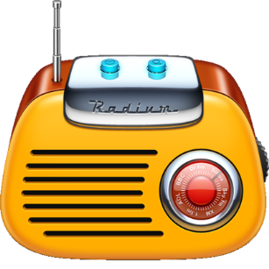
Declining listening time for radio
Change in measurement
01.10.12
P1+ from 02.10.13
NRK «other» 7 min
Minutes
Source: PPM from week 17 – 52 2006*.

Slide 7
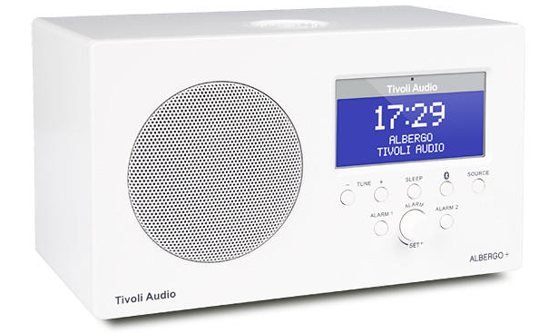
The fragmentation is on it’s way
Percent
Source: PPM. Daily reach 2016.

Slide 8
High access to radio equipment
Percent
Spørsmål: Når du lytter på radio/radioprogram er det mange mulige typer teknisk utstyr som kan benyttes. Hvilke typer teknisk utstyr har du eller din husstand til å høre på radio?
Source: DRU. Kantar TNS Oct/Nov 2016. Base n= 1404 (all)
Notes:
DRU 10

Slide 9
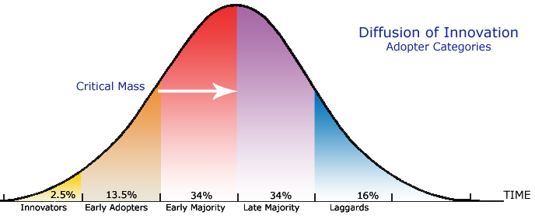
Diffusion of Innovations:
Media & media technology
DAB radio 74%
Tablet 70%
Facebook 71%
Netflix 34%
Health bracelet 16%
Critical Mass
Smart watch 10%
Twitter 7%
Smartphone 88%
PopcornTime 3%
LinkedIn 3% Virtual Reality 2%
Source: Diffusjon og bruk av Facebook i Norge (Futsæter & Frønes, 2013).
Sosiologisk tidsskrift nr.4 2013. Daily use for Facebook, Twitter & LinkedIn

Slide 10
Amount of daily digital listeners:
70% of the listeners are digital
Percent
Internet radio: PC/Mac, mobile (apps) radio, tablet, WiFi- internet radio.
DAB-radio: DAB-radio (incl. adapter), DAB-radio in car (incl. adapter), DAB-pocket radio
Digital TV
Source: DRU. Kantar TNS. Base: Those who listening to radio yesterday.
Amount of the listeners who listen to at least one digital receiver daily.
Notes:
DRU 25, Q21

Slide 11
Access to digital radio equipment
Percent
Internet radio: PC/Mac, mobile (apps) radio, tablet, WiFi- internet radio.
DAB-radio: DAB-radio (incl. adapter), DAB-radio in car (incl. adapter), DAB-pocket radio
Digital TV
Source: DRU. Kantar TNS. Base n= all
Notes:
DRU 11

Slide 12
Total digital access and DAB in January 2017
Internet radio: PC/Mac, mobile (apps) radio, tablet, WiFi- internet radio.
DAB-radio: DAB-radio (incl. adapter), DAB-radio in car (incl. adapter), DAB-pocket radio
Digital TV
Percent
Source: DRU. Kantar TNS. Base n= all. January 2017.

Slide 13
Amount of listening time on different platforms
Percent
Source: DRU. Kantar TNS. Base:Those who listening to radio yesterday.
Notes:
DRU 36

Slide 14
The challenge with radio listening in cars
86% own at least one car
66% say that it is important to listen to radio in cars
51% listen daily to radio in cars
32% of those who have radio in cars have DAB in at least one car
22% of the total listening time in cars: 15% by FM and 6% by DAB
49% of those who have cars and not DAB will wait until FM shuts down (nationally) before they will install DAB, and only 6% will never install DAB.
Source: DRU. Kantar TNS.

Slide 15
Amount of listening time on different platforms at home and in cars
Percent
Source: DRU. Kantar TNS. Base: Those who listening yesterday.
Notes:
DRU 37, De resterende har benyttet andre enheter enten hjemme eller andre steder

Slide 16
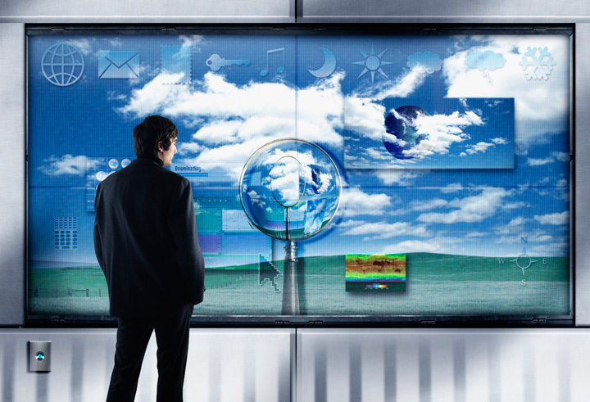
Future perspectives

Slide 17

Drivers and barriers
for DAB-radio listening
More access to stations for everybody
Better access for all stations everywhere
New services
  Text display – traffic info
  Pictures
  Program information
Better user interface
Better sound quality
  Stable access and better quality
Have to change the radio (or buy an adapter) for the most used FM devices
FM-radio in cars (expensive and difficult)
More completion from other media
Some will perceive the new user interface as difficult
!

Slide 18
Drivers for listening in 2017 -
Unique characteristic of the radio as a medium
Content: Entertaining, useful, important, informative, credible, social - "a friend", presence, live
Edited content and music
Secondary activity & multi-tasking: Can be used while doing something else
The radio channels have many loyal listeners
High access to radio equipment
Radio has a great potential in relation to mobile phone
Accessibility: Everywhere & Anytime, WiFi, headset (widespread and socially acceptable)
Wireless and multi-room home audio systems (eg. Sonos)
The loyal listeners will acquire digital radio equipment!
!

Slide 19
Radio listening
2017 2018
NRK shuts down FM first and NRK will loose listeners and listening time.
Commercial radio will win listeners from NRK since NRK shuts down FM first.
Local radio transmitted on FM and DAB will likely result in increased listening.
All stations will loose if the listeners don’t replace the most commonly used FM radio - (eg. in cars).
Daily reach will be reduced slightly.
Listening time will be reduced more.
Radio figures for NRK will increase.
Radio listening can be reduced if people do not replace the most commonly used FM radio - especially in cars.
Daily coverage will increase compared to 2017.
Listening time will increase compared to 2017.
!
Notes:
På kort sikt i 2017 og begynnelsen av 2018 vil radiolyttingen bli redusert noe,
men deretter vil den øke

Slide 20

Knut-Arne Futsæter Kantar TNS http://www.tns-gallup.no/medier
@Futsaeter

