Slide 1

Finding advantage in a connected world

Slide 2
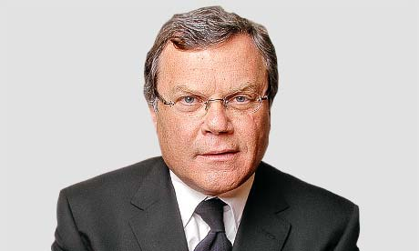
“I don’t think there are threats, I think there are opportunities. The trouble with opportunities is, if you don’t deal with them, they can become threats”
– Sir Martin Sorrel
4
Notes:
The WPP view here is quite simple; the range of opportunities in front of us is wider than ever before, and the only real danger is in ignoring them. Staying motionless whilst our competitors act and create new sources of competitive advantage. So lets explore the landscape in front of us, and consider the steps we need to take

Slide 3



Fragmentert medielandskap – hvor er målgruppen?
6
Notes:
Lets start with the media landscape. We’ve been hearing for years about the fragmentation of media, and of core audiences, and the real challenge this creates in trying to find your audience

Slide 4
Vi går fra segmenter til individer
7
Notes:
We’ve been hearing more recently about the opportunity to ‘market to an audience of 1’ through a continually enhanced targeting, a greater understanding of content, and real time marketing

Slide 5
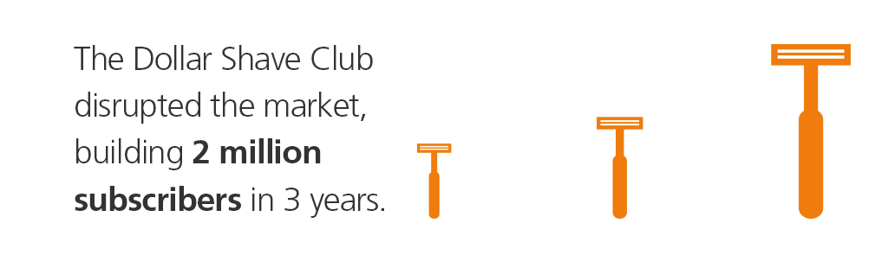
Nye konkurrenter med ny teknologi angriper de uangripelige
8
Notes:
We’re seeing even the most established of industries and brands being disrupted by new entrants and new propositions, that growth hack their way into contention…

Slide 6






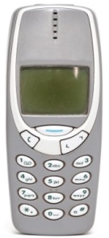


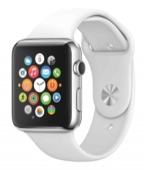
Ny teknologi som kommer stadig raskere...
10
Notes:
Finally we’re tasked with an every growing range of technology fuelled opportunities and challenges that it feels almost impossible to get to grips with

Slide 7
Men det grunnleggende endrer seg allikevel ikke
Forstå
Kommunisere
Engasjere
Aktivere
Betjene
11
Notes:
…but for those of us that are consumer-centric, this tech simply represents new tools to do the same jobs: understand, reach, engage, activate and serve our customers

Slide 8
Fra utfordringer til muligheter
Utfordringer:
Fragmentering
Aksellererende
innovasjonstempo
Nye
trusler
Fra segment til
individ
Kunden i sentrum
- alltid!
Utnytt nye kanaler
og løsninger
Muligheter:
Kontekst
Fart
Service
13
Notes:
What we’ll hear about over the next hour is three data-driven opportunities, that help you remove these threats and focus in on the opportunities, ultimately enabling you to find advantage in a connected world –
Finding advantage through context will talk about how situational opportunities dramatically improve the results of realtime marketing
Finding advantage through speed will look at the importance of getting to market quickly in a more dynamic marketplace
Finding advantage through service will look at the changing nature of customer service, and it’s stronger role as a driver of competitive advantage

Slide 9
Nye muligheter gjennom ny forståelse av sanntid
Kontekst

Slide 10
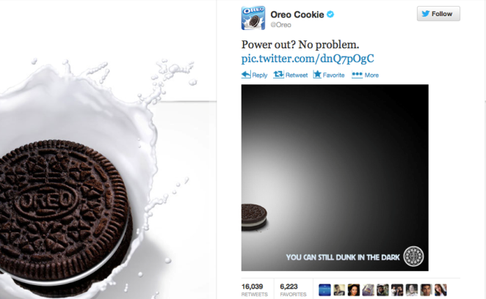
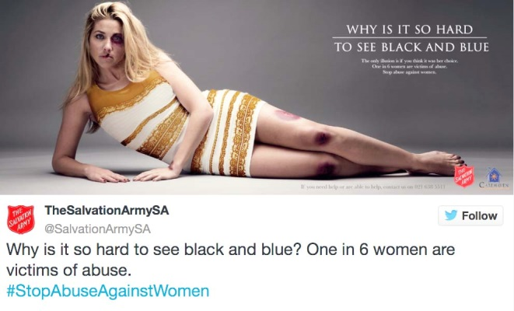
Realtime marketing: Hype eller viktig mulighet?
Realtime marketing: “Responding to current events and stories in an attempt
to make brands more relevant.”
3
Notes:
In other words we use cultural relevance to drive cut through of brand messages

Slide 11
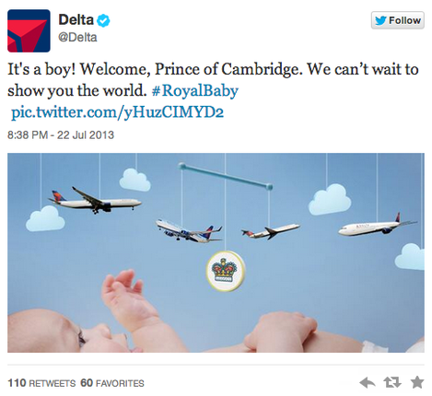
Men en happening ikke alltid er et relevant øyeblikk for ditt merke…
4
Notes:
Apart from the comments you and Rosie are explaining , I had a comment around reference to cultural .
Could we define what we mean . To me cultural means something much more ingrained in an country– for example Spanish culture takes time to enjoy a meal including lunch – so marketing can respond to this broader cultural behaviour – as opposed to a specific cultural event which may be running with the bulls.
I think we can use it – maybe we just need to say by cultural events we mean XYZ

Slide 12
Hva om vi re-tenker dette med realtime litt...

Slide 13
Det dreier seg om å treffe på det som er relevant for kunden der og da
Manglende fokus =
lav effektivitet
Re-fokusering
Effekt
3%
Mikro-øyeblikk:
  Sted
  Interesseområder
  Ukedag, tid
  Hvem
  Device
60%
7
Notes:
CASE: L
In this example we took a client that had low click-through rates on their ads (as almost all of us do), but then identified the moments, locations, situations and targets when this rate was much higher; when it hit 60%. Feeding this back enabled the client to go after those highly engaged moments, buying ad space against the precise targets, and moments when their creative was really working

Slide 14
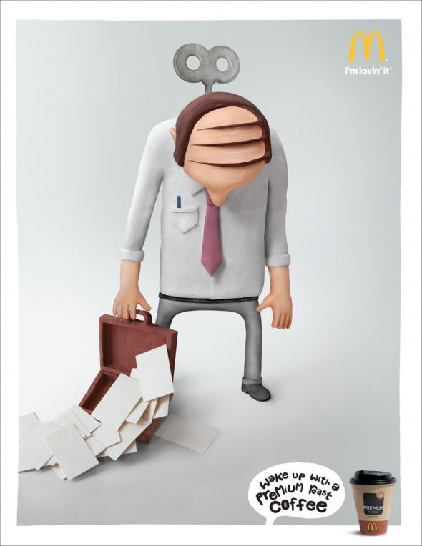
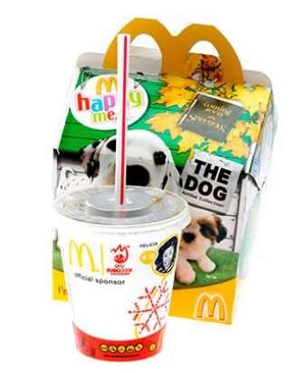
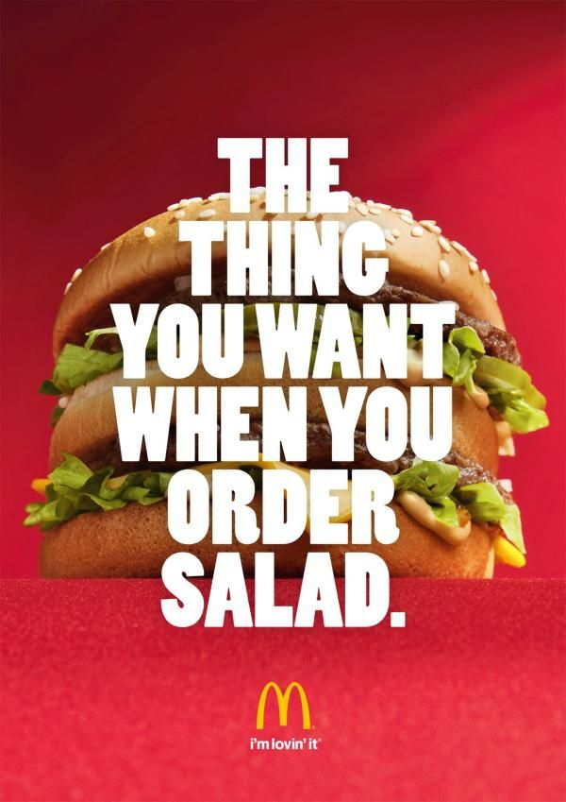
Forskjellig tid på dagen – forskjellige budskap
Morning coffee
Kids and fun
Pure taste
11
Notes:
They update their menus, but could they update their messaging to more effectively tap into the drivers around quality of ingredients, importance of kids, and best tasting food? They do this in their ATL campaigns, but do they do so in-store?

Slide 15
Fordi hva som driver besøk varierer gjennom døgnet
Drivere for besøk hos McDonalds
Best tasting food
Quality ingredients
Kids really enjoy
10

Slide 16
Oppsummert
Forstå i hvilke øyeblikk din merkevare er mest relevant
Forstå hva som er viktig for disse øyeblikkene
Bygg løsninger som fanger opp kontekst-data og gjør det mulig å bruke dem aktivt
Fokuser budskap, produkt og ressurser rundt disse øyeblikkene og driverne.
De beste eier øyeblikket!
12
Notes:
There’s a problem with real time – too much focus on cultural events or occasions that carry no relevance for the brand
We have to redefine it – the real focus should be on moment marketing, delivering messages based on what consumer occasions, throughout the day and in realtime
Next steps – Uncover when the brand is the most relevant and what the situational drivers in each of those moments is, and align messaging, propositions and budgets behind these moments and drivers

Slide 17
Hvordan vinner du innovasjonskappløpet?
Fart
Notes:
In a connected world where advances in technology, and even more so the emergence of social media are:
dictating the way in which consumers interact with our brands,
redefining consumer first moment of truth,
affecting the way in which consumers are expecting our products to deliver
the big question which we need to ask ourselves today is:
How do we keep pace with this change in consumer dynamics to ensure that our innovation is engaging and relevant to the consumers which we are looking to serve?

Slide 18

Hvorfor tar det altfor ofte alt for lang tid fra idè til lansering?
4
Notes:
But first of all, what is it that typically slows down speed to market? Why is it so hard for innovation solutions to reach the market sooner, so that they can have the advantage of being first to market?
There are a number of things that have surfaced in our conversations with clients – things that are critical considerations, but which, if looked at differently, can make a huge difference to the efficiency with which we go through the innovation journey.
The foremost obstacle to speed is the need to balance it with rigour – the importance of getting everything absolutely perfect. This has typically meant extensive and prolonged internal and external processes – whether this is with respect to research, or internal stage-gate processes where caution often leads to more complexity than is ideally warranted.
Getting budgets and appropriate resources allocated to innovation is often a challenge too, and misaligned internal priorities can make this much more difficult. Talking to clients, we find it isn’t just misalignment across functions, but also within the same function. The stage gate process was described as complex and disjointed.
And of course, there are the well-known limitations of market research – traditional survey research can be time consuming and blunt, not flexible and iterative enough to allow ideas to realize their full potential.
But one of the biggest obstacles which we found is that a lot of our clients were saying that they don’t have creative resources: a lot of them are finding their own insights and writing their own concepts to then go and create. So while qualitative ideation approaches are often successful in nurturing and developing strong ideas, resource limitations often come in the way of scaling these and maximizing their impact.

Slide 19
Utfordringen fra Danone: Identifiser produktet som kan ta Activia kornblandinger fra OK til markedsledende i løpet av 2 uker!
7
Notes:
To test this, we partnered with Danone to help them find a breakthrough innovation within seven days.
Danone approached our team in France a couple of months ago (January 2016) with a challenge concerning their biggest dairy brand, Activia …
Activia by Danone is a leading yogurt brand sold in over 70 countries worldwide. Its target audience consists of women who are active, well-informed and health-conscious.
Activia already offers a subrange of cereal yogurts in a number of countries and this subrange is really important for Activia as cereal is the brand’s DNA: Activia means fiber, digestive well-being; but also because there is no clear competition on this subrange so it represents some great growth potential.
, but felt that it was not performing to its full potential among its target.
They needed to address two key questions:
1) How can Activia step-change its proposition to create THE ultimate cereal yogurt?
2) How can the brand achieve growth and leadership in both established and new geographies?

Slide 20
Det er dårlig tid det...
8
Notes:
The Activia Global Strategy & Insights team was under time pressure: they had an important global meeting coming up and were given just two weeks by Danone senior management to crack two of Danone’s key markets specifically: the USA and France - both very challenging markets but with totally different consumption habits.
The Activia team needed to develop winning concepts – that is fully-developed concepts with new a proposition, product and packaging, that will appeal to their strategic target in these two markets – and all under two weeks (in time for their global meeting).

Slide 21
Re-tenking av hele prosessen – ekstremt fokus på fart og interaktivitet
Step 1
Step 2
Step 3
Step 4
Insight generation workshop
Ideation through
global
crowd-sourcing
Concept development workshop
Quantitative
concept testing
10
Notes:
To help Danone address their challenge, we suggested using our ‘Seven’ approach.
Seven is an intensive and integrated approach that delivers validated concepts in just seven working days – a process which typically takes several months.
It encompasses the insight generation, ideation, concept development and quantitative testing stages, with the promise of delivering winning concept(s) by the end of the process.
The first step, insight generation, is crucial to the success of the entire process: during this intensive two-day workshop, the client team and TNS teams work together to identify the growth opportunities for the brand and select the insights that are aligned with the brand’s strategy.
These insights are then developed into an ideation brief which is posted over the weekend to a global community of 325,000+ creators spanning 160 countries.
Ideas come back to us on Monday morning, and the next two days are spent refining the best of these into full-fledged concepts.
The last stage is quantitative screening of the concepts, which takes place on day 6, with the results coming in on day 7.
Key to the success of this creative and disciplined process is the involvement of our senior Qualitative and Innovation Experts as well as the active participation of the client’s team at every stage of the process throughout these seven working days.
In the case of the Danone Activia project, their team involved marketing and insight people from their global and local teams, as well as people from their packaging and R&D divisions.

Slide 22
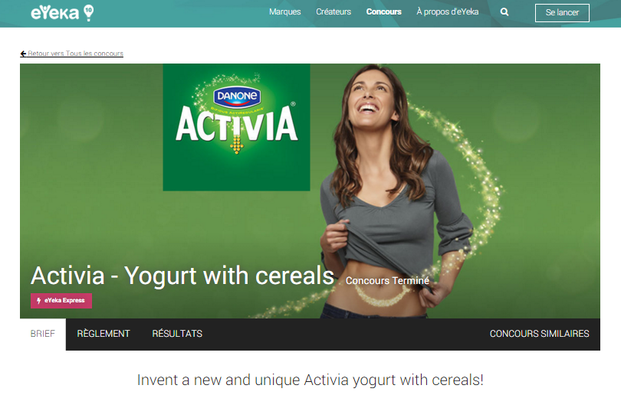
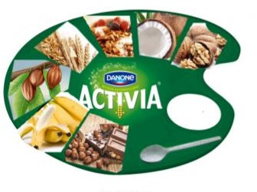
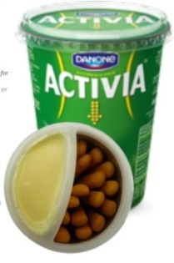
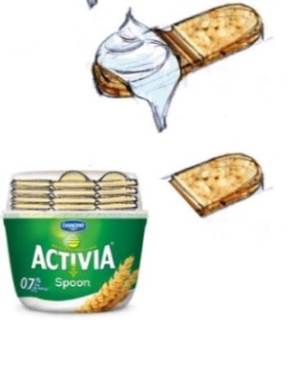
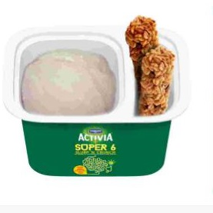
Kjernen - Idè-generering gjennom crowdsourcing
51 new ideas in 48 hours
5
concepts
developed
325 000 panelister – 160 land – 2 dager – 50 ideer
12
Notes:
We received over 50 ideas from the crowd within 48 hours, which were really creative and delighted our client (and us!): these ideas looked at packaging, design, shape, ingredients, experience, different moments of consumption.
We selected five ideas and developed them into concepts with our client team (NB: none of the top five concepts are shown on this slide for confidentiality reasons – these are just examples of some of the 51 ideas submitted by the online community). Also interesting to note is that the selected ideas had been submitted by community members based in various markets such as Russia, Italy, Poland, etc. (i.e. not necessarily from the 2 target markets of our project)
These five concepts were then tested quantitatively.

Slide 23
Minneverdige øyeblikk – Service-kanaler som relasjonsbyggere
Service

Slide 24
To av tre kunder velger et annet merke neste gang
3
Notes:
Customers today have more choice than ever before. Not only have products and services proliferated in many categories, they have also become more and more interchangeable in the eyes of the customers. From a company’s perspective, customers are becoming less and less loyal. Our global customer survey showed than when asked whether they had bought a new product within the past year – like a car, a computer, or a TV – almost two thirds of respondents said that they chose a different brand than the one they had previously owned. In other words, companies lose two out of three customers to competitors.
Source: CIS 2014

Slide 25
Skuffende kunde-service er en hovedgrunn til dette
31%
28%
24%
fikk et bedre
tilbud
var ikke fornøyd
med hva de fikk for
pengene
var misfornøyd med
serviceen
4
Notes:
But why is that so? You might argue that the majority of customers are price-sensitive and always go for a better deal, which not every company is able to offer. Indeed, 31% of customer leave because they received a better offer from a competitor, and 28% because they were unhappy with the value for money. However, an almost as high number, 24%, stated they left because they were dissatisfied with the service they received – a factor over which companies have full control. This makes service failure a leading cause for churn, and only highlights the importance of services being delivered successfully and hassle-free.

Slide 26
Alle kanaler er service-kanaler
5
Notes:
If only it were that simple, though. Looking at the landscape of services today and comparing it to how it was a few years ago, one thing becomes immediately noticeable. Recent developments in technology have led to an explosion of digital communication channels. Social media and various messenger platforms have become an integral part of our lives, and we access them through multiple devices, such as computers, smartphones, or tablets. While they open up exciting possibilities for organization and communication in our day-to-day life and work, they are making service delivery tremendously more complex.
Already, two thirds of customers (62%) use two channels or more when interacting with a company to solve a service request. With social networks gaining popularity, they are being added to the mix, leading to 87% of customers now using a so-called “new digital” channel (like Twitter, WeChat, or other social media sites) in combination with the more conventional channels.
Of course, these new channels pose a number of challenges to companies: Most digital channels are always available and “open”, causing the expectation that customer service will be delivered 24/7 . Also, the majority of conversations on social networking sites are public. This leads to a never-seen-before transparency, where successful interactions but also expressions of disappointment and anger are out in the open for everyone to read. Finally, they require a new casual and personal style of communication, and many companies have a hard time adapting to that.

Slide 27
Er god service i alle kanaler svaret da?
Notes:
In short, successful service is key to keeping customers loyal, but the diversification of channels has made servicing them right so much more difficult. What is the secret to securing customer relationships in this ever changing environment?

Slide 28
Forstå hvordan gode opplevelser forvandles til preferanse for merket
Opplevelse
80
Opplevelse – Preferanse gap
41
60
Totalinntrykk
Preferanse
39
7
Notes:
Companies must, of course, deliver a good performance, in the sense that products and services come with the quality that customers expect. But that is not all. Another crucial factor is how strongly customers prefer the company over competitors. The trick therefore lies in translating performance into preference. In other words, it’s about making sure that customers not only like a company’s products and services, but that they will also reliably choose it over others. Not all companies are successful at that, and it is especially difficult in highly competitive environments.

Slide 29
Preferanse er nøkkelen til vekst – manglende preferanse = lav vekst!
15%
10%
5%
0%
(5)%
Annual growth
(10)%
(15)%
(20)%
Preference-Growth Correlation 0.6
Performance-Growth Correlation 0.3
(25)%
10
20
30
40
50
60
Customer preference
Business units of the organisation
SOURCE: Case study – Service provider
8
Notes:
The reason why preference is such an important thing to investigate is that it directly links to profit. In our case study of a large B2B service provider, we see a strong correlation between the preference score achieved by a business unit and their annual growth. Hence, being a customer’s preferred provider is key to growing revenue.

Slide 30
Så hvordan kommer vi fra gode opplevelser til preferanse?
Notes:
Today’s complex service landscape of diversifying communication channels offers various new opportunities to drive customer preference through their experience of touchpoints. A case study from the airline industry shows how.
Case study sources: TNS Customer Strategies Airline Survey 2014/2015
Connected Life 2016

Slide 31
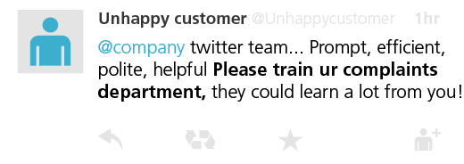
Det holder ikke å levere bra på det som er viktig, om det ikke bra nok i forhold til konkurrentene
Opplevelse
100
Airline customer @customer
@Airline is good, but I definitely prefer @Competitor. Better cabin, food, & service.
84
Totalintrykk
Preferanse
69
10
Notes:
Like many companies, our airline faces the problem that they are not able to turn good performance into preference. Their TRI*M Index of 84 is strong, and their performance score of 100 indicates a more than solid service delivery across various touchpoints. However, a look at the competitive landscape reveals that this is not enough, as customers can choose from a variety of equally great carriers. Seven (23%) of the airline’s major competitors have stronger relationships with their customers. Another 13 (42%) are performing equally well. Hence, our airline does not manage to really become their customers’ first choice, which is reflected in their relatively low preference score of 69, and the large performance-preference gap of 31 points. Just as the this tweet says, the airline is good, but I definitely prefer a different cone.

Slide 32
Bruk nye kanaler riktig når de er viktige for kunden
@Flyselskap #@☹%&$☹!!!!
4 X
Sannsynlighet for fortsatt kunde, som bruker mer penger, og anbefaler selskapet til andre!
Vi skjønner at du er skuffet– dette er ikke godt nok av oss.
=
Dette ordner vi!
Kudos & takk til @Flyselskap Social Media team for strålende håndtering av en frustrerende situasjon! #HappyCamper
13
Notes:
If positive emotional experiences strengthen preference and hence the overall relationship between customers and the companies they use, what does that mean for how a company manages their various service channels? One might argue that delighting every customer is unrealistic, expensive, and too difficult to do through electronic communication. But the opposite is true. New digital channels offer unique opportunities for companies to manage their customers’ emotional experiences. It is Twitter and Facebook where customers express their excitement, happiness, anger and frustration. And because it’s all out in the open and interactive, companies can address them instantly, becoming an even bigger part of customers’ positive experiences and turning negative experiences into positive ones. Let’s look at how the airline responds to passengers’ complaints through their Twitter service account. The team adopts a personal, human style of communication that is unusual for most customer service interactions but suits the channel very well. Statements like “we understand you’re disappointed” and “that does sound frustrating” clearly acknowledge the customers emotional distress, conveying to customers that their complaints are taken seriously. When successfully solved, such interactions are highly likely to leave customers with a good feeling.

Slide 33
Oppsummert
Du kan ikke være best på alt – fokuser på å skape magi der det er viktigst for kunden
Forstå kundens følelser – opplevelser med sterke emosjoner huskes lenge
Nye kanaler åpner muligheter for å levere nye ekstraordinære opplevelser – grip dem!
Opplevelser må være konsistente på tvers av kanaler
Bygg løsninger som fanger data om kunde, situasjon og opplevelse og bruk dem til å skape bedre løsninger!
16
Notes:
In summary, we learn the following things:
1. Good touchpoint performance is not enough. You need to be excellent where it matters to your customers to prevent them from leaving.
2. Emotions are key to creating memorable experiences that close the gap between performance and preference and help retain.
3. New channels are a major new opportunity to deliver memorable experiences. Use these new opportunities and challenge your traditional service delivery along the lines of its strengths.
4. Customers tend to use multiple service channels. You need to be consistent, aligning service delivery and quality across all of them.

