Slide 1
The new print and online contract
EMRO: 22.05.17
Bente Håvimb MBL & Knut-Arne Futsæter Kantar TNS
Notes:
We would like to present the new joint print and online contract in Norway.

Slide 2
Agenda
Introduction
The online measurements
The newspaper measurement
The magazine measurement
The Target Group Index: TGI
Reporting
Future perspectives
Notes:
My name is Bente and I am the successor of Helge Holbæk Hansen at MBL (The Norwegian Media Businesses’ Association). Since Helge is busy enjoying his garden in Greece, I will be the new EMRO country contact for Norway. Alongside Knut-Arne from Kantar Media I will guide you through the new print and online contract which is currently being implemented in Norway.

Slide 3



1. Introduction
Bente Håvimb
Notes:
Before we get into more details about the contract, I would like to take the opportunity to introduce myself.
This picture is from my hometown Oppdal, although I must confess that this amazing skier isn’t me. I am very happy to join this conference for the first time here in Luzern where the landscape is much similar.
I only started working at MBL 7 weeks ago, so there is still a lot to learn. Before I was so lucky as to attain this position, which many of you know Helge has been holding tight for more than 20 years, I have been working with research from different angels – Both within the global markert research institutes and lastly at Norways largest digital only newspaper.

Slide 4

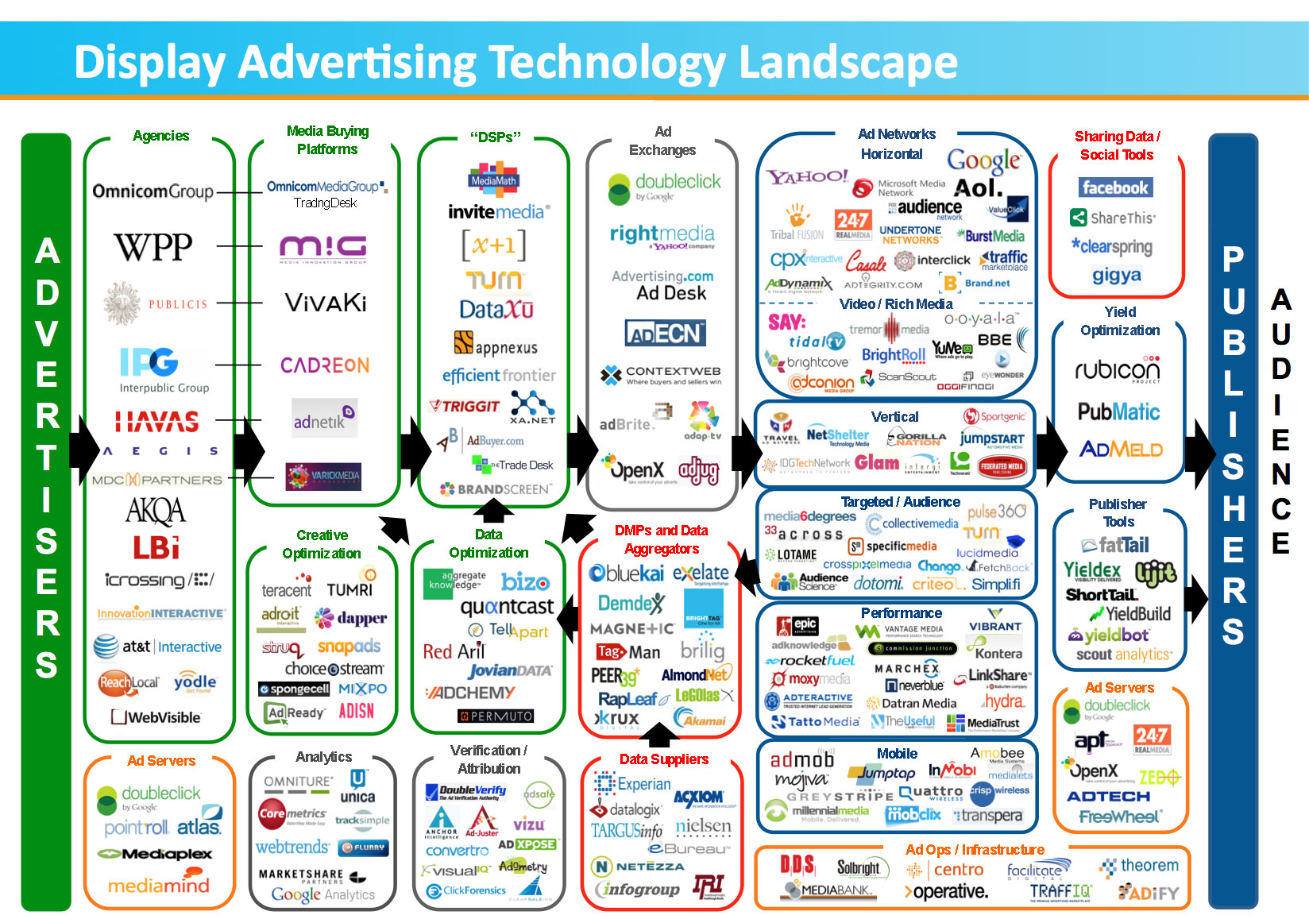
The «new world»
Notes:
So – over to the essence of this speach. Last year Helge talked about the shifting landscape of the media, focusing on digital disruption involving new technologies, marketplaces and business models affecting the value proposition of existing services.

Slide 5
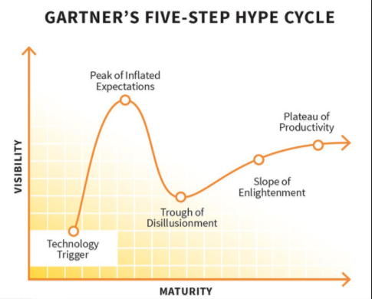

Programmatic Hype Cycle
New tech-vendors
Low transparency
High transparency
Fewer vendors
Familiar companies stepping up
Notes:
Programmatic trading is one major example. Norwegian agencies have largely embraced new opportunities the last few years, only to see diminishing growth through 2017. The major reasons for this is uncertainty regarding data validation, adfraud and arbitrage. Within the approaching slope of programmatic enlightment lies great possibilities for new eco-systems and future DMPs.

Slide 6
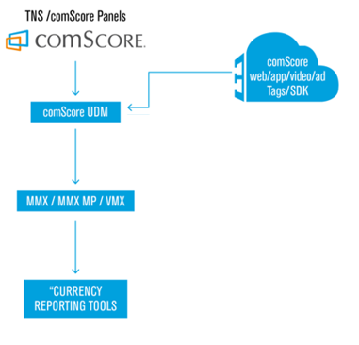
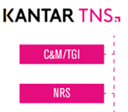


A new eco system?
The new contract unifies the separat contracts running until the end of 2017.
Possible future scenario:
Notes:
This is a simplification of such a possible future eco-system where unified measurements and the existing TGI (target group index) from Kantar TNS merges into a unique DMP making data available in new ways.
In addition, close to half of the Norwegian population, (aged 12 and up) will be logged in with a unique ID when accessing online titles, incuding more than 2 million IDs. Adding these data in the mix will make the DMP even more powerful and a valuable asset for media agencies and advertisers.

Slide 7
The need for cencus data
Even in the new world, we need some kind of validated and trusted currency data, maybe even more so.
Important attributes:
Relevancy
Aceptancy
Independency
Credibility
Transparency
Comparability
Susan Bidel (Forrester Research US):
“Keep focusing on the media currency data and other media and
consumer data of high quality.”
Lynne Robinson (IPA UK):
“The reason I am looking for a readership survey is to get a robust
and credible trading currency for all published media”
John Richard Hewitt head of the TVOV steering committee:
“It is critical that broadcasters are making informed decisions using the most accurate, holistic TV currency data, and it is equally important to facilitate holistic media buying decisions at advertisers and agencies.”
Notes:
The starting disillusionment and increased sceptisism that we now notice from actors like The Norwegian Association of Advertisers (ANFO) and lagre advertisers like Procter & Gamble, leads to increased attention towards documentation and a stronger need for trusted currencies in the ocean of data providers.
A common language for publishers, media agencies and advertisers, and a valuable source of information to the authorities.

Slide 8

What did we ask for in the RFI?
A common currency with validated numbers for media usage and data for media planning
The official documentation of media usage in Norway
Linked to a common target group index
3 participants delivered a proposal on all requested surveys (print, magazine and online)
Dataset of usage of all MBL titles, on all platforms and more frequently reported
Transparent and well documented
3 participants delivered online solutions only.
Allowing independent validation of methods and results
Notes:
So – what did we ask for in the RFI?
We asked for a common currency with validated numbers for media usage and data for media planning.
In comparison with the existing well known systems, we thought more in direction of building up a module based and flexible system.
Proposals that took into account the advantage of the available unique IDs through log-in data, would be preferred.
New measurments must cover the need for official documentation of media usage in Norway - For use by advertisers, the media and the government.
It had to be linked to a common target group index for use with the data.
And it should be possible to connect the index-data to several data- and analytic systems, included SSP/DSP-systems
The service must include a dataset of usage of all MBL titles, on all platforms and more frequently reported.
Norway has as you probably now an extensive media-market including more than 200 newspapers and over 80 magazine titles.
And of course, transparency is needed and the method and technical solutions must be well documented.
This helps secure a higher degree of cooperation between advertisers' agencies and media, even though the service will be owned by MBL.
At last, the contract should allow for independent validation of methods and results through possible external audits.

Slide 9





One joint contract
Strategic partnership
24 months notice upon termination
MBL approval for adjustments
Annual revision
Notes:
Kantar TNS currently holdes the position as the sole provider of official media currencies in Norway (??), and their partnership with MBL dates back more than 25 years.
On the currency level we still have separate contracts for measuring print-version of newspapers, print-version of magazines, TV-meter, outdoor and PPM for radio.
The alliance with comScore dating from February 2015 represents new possibilities for a total eco-system inclusion new online measurements.
The new contract will strive to build new flexible solutions in a rapidly changing media environment, but at the same time secure the continuum we have in the long established measurements.
To secure enough time for development and if necessary downscaling, the contract can be terminated upon a 24- month notice. All adjustments suggested by the involved parties are to be approved by MBL upon implementation, and Kantar TNS is responsible for revising the contract based on MBL strategical expectations once each year. (SLETTE?)

Slide 10
2. The online measurements
Notes:
The Print & Online Contract is between Kantar TNS and MBL, and comScore is the subcontractor for the online data. comScore is the world leaders in online measurements and they are reporting digital content in 44 markets.

Slide 11
Internet measurement history
1995 Systematic measurement of Internet sites
1998
TNS Metrix
2005
TNS Mobile
2010
Norwegian Internet Panel (NIP)
2014 ->
NIP 2.0
11
Notes:
However, as I have told you many times at EMRO we have a long history of measuring Internet sites in Norway and we are now entering a new era.

Slide 12
The three Internet measurements
Spring Scores
Technical
Unique visitors
NIP (panel)
Technical
Persons
Census
Sample
Internet
Internet
Multimedia
Sample
Persons
Recall
Consumer & Media
12
Notes:
From 2009-2017 we have a hybrid methodology system consisting of three measurements:
The site centric browser measurement system TNS Scores gives detailed traffic measurements for all Norwegian web sites.
The Norwegian Internet Panel measures Internet usage at work and at home for all websites measured in Scores.
The multi-media survey C&M produce official currency figures for local newspapers. The survey makes it possible to perform various analyses such as cross-platform, multi-media and target group analyses.

Slide 13




Unified Digital Measurement: UDM
PERSON Measurement
(passive person-centric)
DEVICE Measurement
(site-centric)
PANEL
CENSUS TAGS
Unified Digital Measurement (UDM)
Notes:
The disparity between census and panel data has since 2009 been the Achilles Heel of digital measurement in Norway and in other countries. The two measurement have different objectives, they employ different counting technologies, which often results in differing metrics that can cause confusion an uncertainty among publishers, media agencies and advertisers.
This approach combines person-level measurement from the 2 million person comScore global panel with census data to account for 100% of the use.
Participating companies place tags on all their content – web pages, videos, apps and ads, and these calls are recorded by comScore servers every time content is accessed. comScore is able to view these calls on its global panel in addition to measuring the census tag calls.

Slide 14
Integration of census and panel data overcomes deficiencies
Data asset | Deficiency | Unified solution
Panel | Volatility in the long tail, limited granularity | Census data introduces increased granularity and stability for smaller media entities
Panel | Challenges measuring the entire detailed traffic (and also mobile: in-app, new channels, secure) | Census data assures that all activity is credited
Panel | Behavioural biases accruing from recruitment and sampling | Census data provide an opportunity for calibration
Panel | Limited flexibility to expand to new digital platforms | Census data can quickly cover new platforms and deliver platform de-duplication insights
Census | Incomplete coverage of tags (e.g. tags falling off a part of the site, not-collaborating publishers) | Panel data allows for identifying and quantifying the extent of coverage gaps
Census | Impossible to translate cookies to persons on multi-user desktop computers | Panel data provides cookie-to-person conversion factors at the site level
Census | Impossible to assign demographics to traffic without panel inputs | Panel data provides demography
Notes:
comScore has implemented a panel-centric unified solution to audience measurement, creating a combination of these two methodologies into a “best of breed” approach that provides a direct link between census and panel approaches. Therefore, the integration of census and panel data will overcome deficiencies which you can see in this table.

Slide 15
Unified Digital Measurement (UDM) solution
Enumeration
Unification of Census and Panel data; QA
Panel Recruitment
UDM
Dictionary: Aggregation into reportable entities
Data
Collection: Census + Panel
Sample selection and weighting
Unification
Notes:
However, the approach is more complex than that since the unified digital measurement solution also is using other elements such as enumeration survey to define the overlaps and multi-platform definitions to produce MMX MP. And there are a lot of other elements and calculations that I don’t have time to discuss here today.

Slide 16
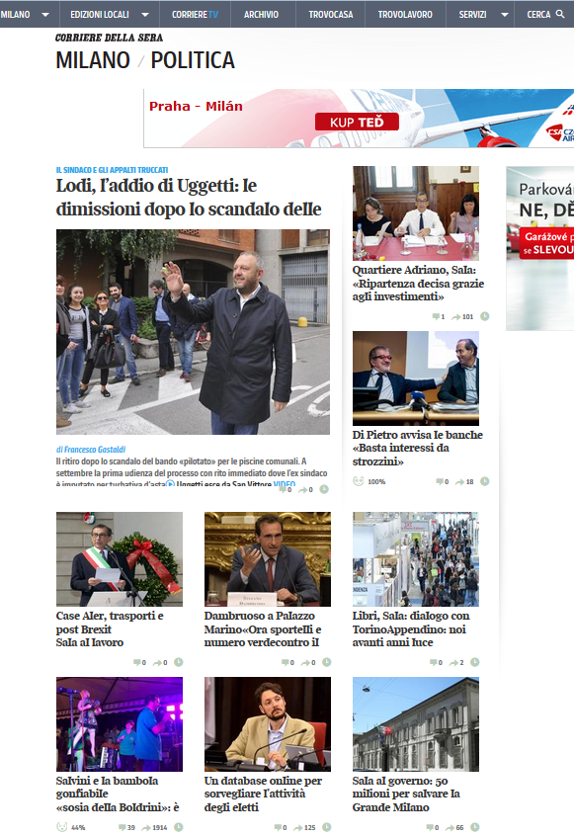
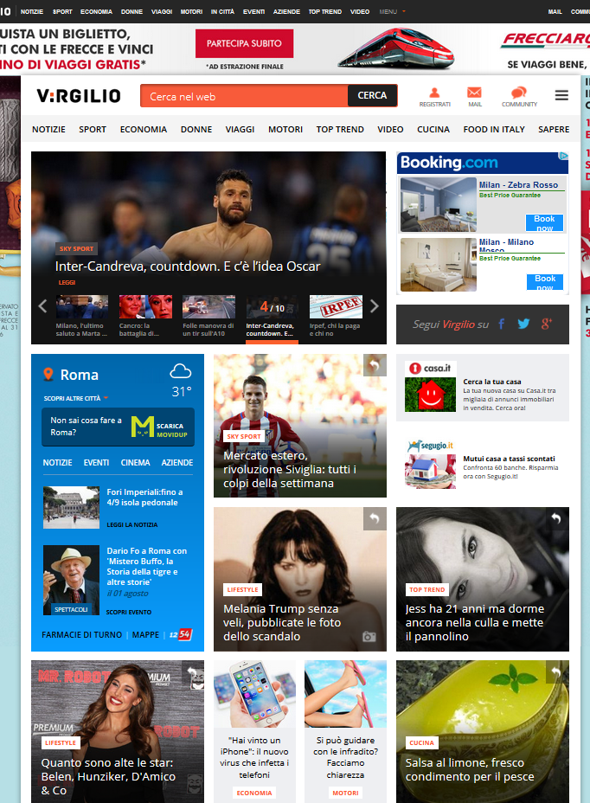

The data integration prosess
Demographic targets
Enumeration resource
Panel
Panel projections used if an entity is not tagged (+ aggregation defined by the CFD)
Panel with comScore software meter
Production sample
Sample Weighting
Final data
(MyMetrix interface)
Non-tagged entities
Census Informed Targets
Weighted sample: Entity’s Cookies per Person, Duration
Unified Digital Measur.
Behavioural
targets
Tagged sites and videos
Census data
Census totals by entity
Cookie deflation factor applied
Aggregation defined by the Dictionary
Panel estimates used if tag coverage incomplete
Notes:
One of the main elements in the UDM is the data integration process. This slide outlines the UDM flow applied to desktop data to calculate desktop audience results, however UDM is applied to all platforms.
It’s an integration of census and panel data.
Reports accurately on tagged and non-tagged content.
Cookie per person calculated for each reportable entity or media separately.

Slide 17
Data Integration for mobile and tablets (UDM)
UNIFICATION
TRAFFIC ALLOCATION
DEMOGRAPHIC BIAS CORRECTION
DATA COLLECTION
PANEL RECRUITMENT
ENUMERATION
Notes:
UDM applied to mobile is shown on this slide. The solution is slightly different compared to desktop but the main principle remains unchanged: Audiences of non-tagged entities are projected from weighted samples and the case of tagged entities the core input are census data.

Slide 18
Total digital audience: MMX Multi-platform modelling
Cross-device behaviour observations at an individual person level
(Single source: Dynamic Panel)
Model development and training
MLE statistical framework
Entity Audience Results per Platform
Desktop (UDM)
Mobile
(UDM)
Inputs
Overlap
Model
Result
Web
Video
Phones
Tablets
Generalized algorithm:
De-duplication occurs at the lowest reportable demographic break level
Notes:
And the total digital audience MMX Multi-platform modelling looks like this:
comScore applies multi-sourcing approach to measure each platform audience by the best available techniques, to preserve results of underlying products, to have a flexible future-oriented product design.
De-duplicated cross-platform results add a new layer on top of the underlying assets
The overlap methodology is based on modeling techniques that are currently deployed in other JIC markets such as UK and Spain.

Slide 19

3. The newspaper measurement

Slide 20
The newspaper measurement
Collected by CATI and integrated in the multi-media concept Consumer & Media
Will measure and report reach and frequency across platforms, screens and devices
The new contract is flexible when it comes to yearly revision of methods and sample sizes. The sample sizes will be from 35.000 to 45.000 interviews yearly
The newspapers will still be using the Pure Recent Reading (PRR)
Notes:
The Newspaper readership measurement will be collected by CATI and the survey will still be integrated in multi-media concept Consumer & Media.
The new system will measure and report reach and frequency across platforms, screens and devices.
The research industry and the JICs are under severe financial pressure and the ad income for print media in Norway has dropped dramatically the last years. As a consequence of these changes, the new contract is flexible when it comes to yearly revision of methods and sample sizes. The sample size will be 45.000 interviews in 2018 but could be reduced to 35.000 later.
The newspapers will still be using the Pure Recent Reading method for calculating readership figures.

Slide 21

Brand First is the best method for reporting figures from all platforms
Recall methodologies have their limitations
We have to combine traditional surveys with passive electronic measurements and use more and more data integration
Total | X
Desktop | X
Mobile | X
Tablets | X
E-Paper (PDF) | X
Paper | X
Notes:
Brand First is the best method for reporting figures from all platforms and the total brand footprint.
Recall methodologies have their limitations when it comes to measuring all types of digital content. So, we have to combine traditional surveys with passive electronic measurements and use data integration to a much greater extent to report consumption of digital content in the traditional NRS databases.

Slide 22
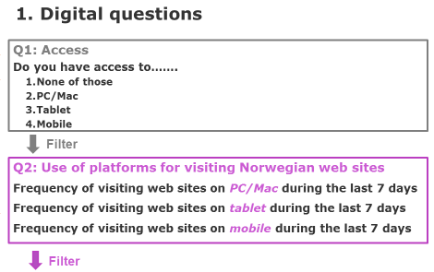
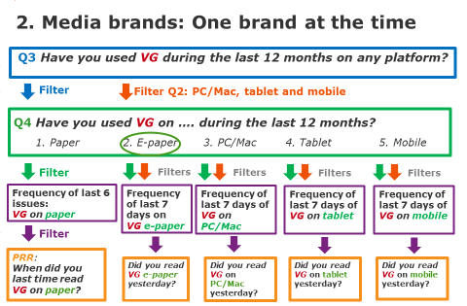
New Brand First test in 3Q 2017
..
Notes:
As pointed out at the last years EMRO meeting we will change to the Brand First method to be able to measure all platforms. Since the test in 2016 pin pointed some serious problems, we will have to conduct another test in 3Q 2017.
The new test will start to measure the paper editions before we turn to the digital questions. After asking about use on the three platforms we will ask about e-Papers.
We hope to present the test results on next years EMRO meeting.

Slide 23









4. The magazine measurement
Notes:
The magazine measurements will be carried out by CAWI with a device agnostic approach.

Slide 24

The magazines measurement: 80 paper and 30 online
12.000 interviews
  90% web, 10% self completion
A GEP currency
  Readership (AIR) by Recency
  Readership Engagement Score (RES)
  Number of Reading Occasions (NRO)
  Time spent reading
  Source of copy
Total readership across publishing platforms
  Calibration with comScore
Calibration of readership data
to TGI
Documentation of readership across publishing platforms
Documentation of the qualitative
strengths of Magazines
GEP
Documentation
of gross exposure
AIR
Notes:
We will measure more about 80 paper editions and about 30 online services.
The new readership survey for paper editions of the magazines consists of 12.000 yearly interviews. 90% are carried out on web and 10% with pen and paper.
The readership figures from the magazines measurement and the web titles from comScore will be calibrated onto the TGI data. We therefore have a 360 degree measurement system for the magazine industry.

Slide 25
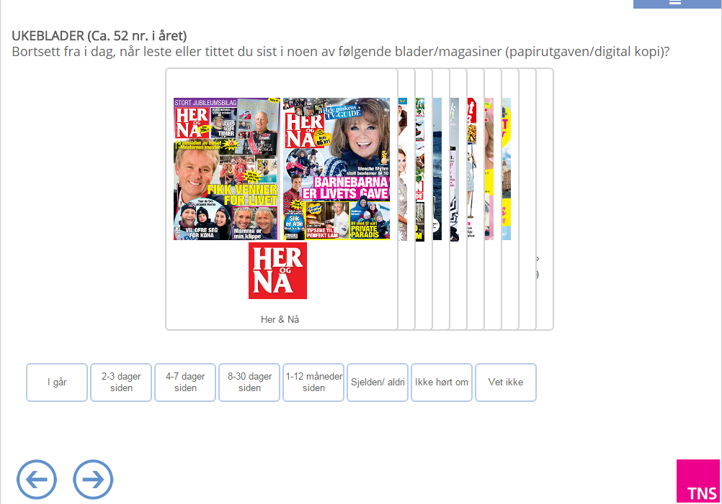
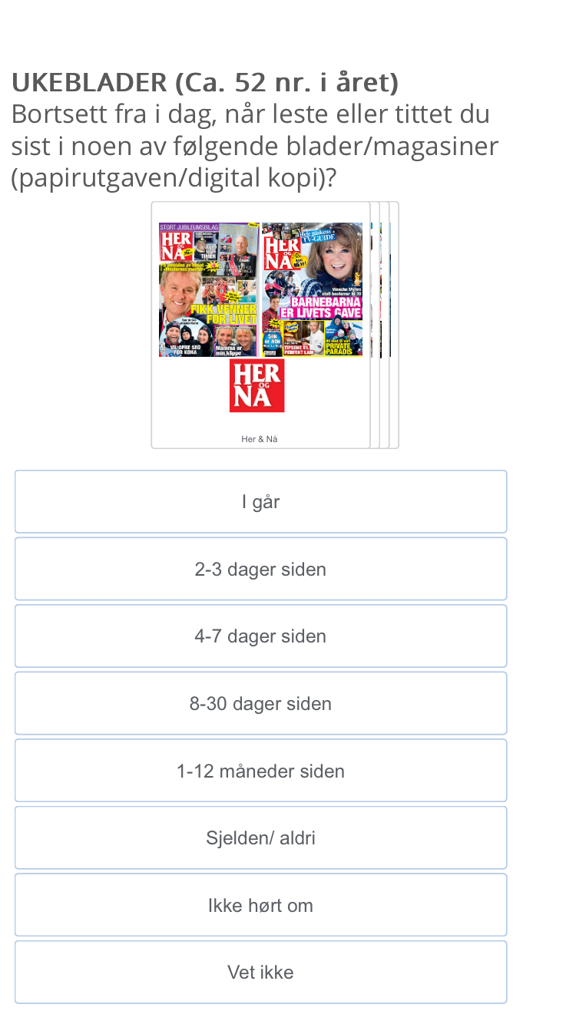
Web-based (CAWI) device agnostic
Desktop
Mobile
Notes:
As presented at EMRO in 2012 and 2013 we will continue to use our access panel for measuring the paper editions.
From 3Q 2016 we introduced a device agnostic approach. The survey and interface is therefore customized to which device the respondents uses.
We use Recent Reading for calculating the readership figures.

Slide 26
The readership numbers (AIR) and Gross Exposure Points (GEP)
AIR (Average Issue Readership)
  The traditional net based readership measure
RES (Readership Engagement Score)
  Amount of reading last time the magazine was read
NRO (Number of Reading Occasions)
  On average, how many reading occasions of a given title
GEP (Gross Exposure Points)
    Quality measures:
    Time spent & source of copy
GEP = AIR x RES x NRO
Notes:
Kantar TNS started to measure magazines in 2012 when we also introduced the new GEP measure.
AIR is Average Issue Readership
RES is Readership Engagement Score
NRO is number of Reading Occasions
GEP is Gross Exposure Points. GEP is calculated by multiplying AIR, RES and NRO. GEP thus gives an estimate of the number of exposures of an average page in a given magazine – a gross figure comparable to the commercial GRPs of radio and TV.
Time spent reading and source of copy are also measured.

Slide 27

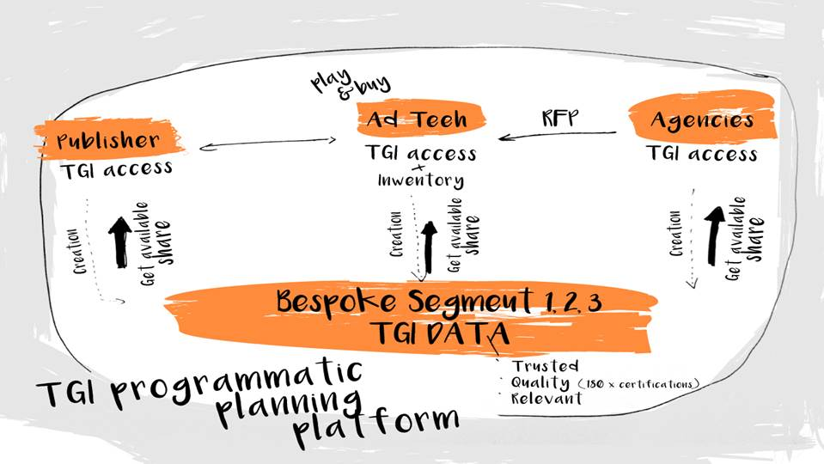
5. The Target Group Index (TGI) and
enrichment of DMPs
Notes:
C&M and TGI have been the most important database and analytics' for the whole media industry in the last 25 years+, and carries the official print, web, mobile and total brand footprint are reported in the C&M.
C&M can deliver both standardized and tailor made target groups for the publishing houses SSP’s.
Consists of a range of 5.000 variables with high quality and transparency, probably far more data and of a higher quality than most of the DMP’s that are used today.

Slide 28
Approaches for connecting data
Direct 1:1 matching
    Connection of known identifications
  2. Exchange of login data
    Use of Facebook, publishing login (SPID, aID)
3. Fusion of individuals
    Depends on common hooks from the data sets
4. Cookie matching
    Lookalike modelling of cookies with similar traffic patterns
5. Profile matching by using similar taxonomies
    Modelling of taxonomies from one source to another
Notes:
As discussed at last years EMRO meeting, there are many approaches for connecting data in the new digital world.

Slide 29
Some approaches for connecting data
Consumer and Media
(45.000/15.000)
Profile matching
with taxonomies
Profile matching
with taxonomies
Fusion
Fusion
NIP
(3.000)
6.000 cookies
Gallup Access Panel (45.000)
15.000 clickstream
Fusion
Profile matching
with taxonomies
Profile matching
with taxonomies
Profile matching
with taxonomies
Publishers DMP
SPID, Amedia, Aller, EHG, TV2 etc.
Other DMPs
DSP, Ad Exchanges etc.
Notes:
There are many ways of connecting our data into external DMPs and we in Kantar TNS have started the journey.
It could be an important step towards premium exchanges and direct programmatic, and gives the media better data to compete with Facebook and Google.

Slide 30
6. Reporting
Notes:
Reporting of the media and TGI data.

Slide 31
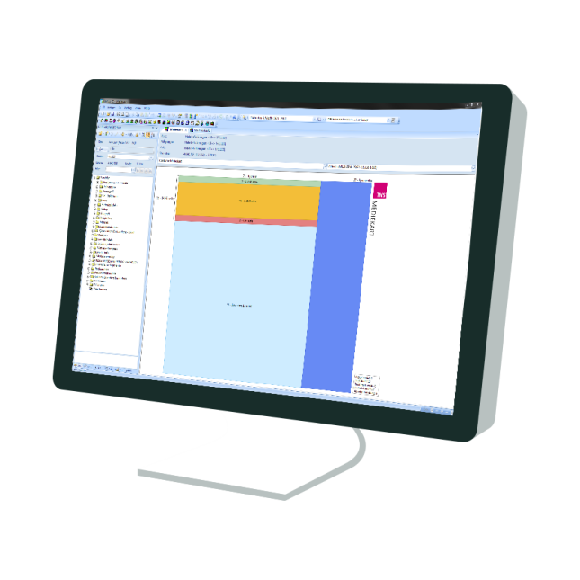
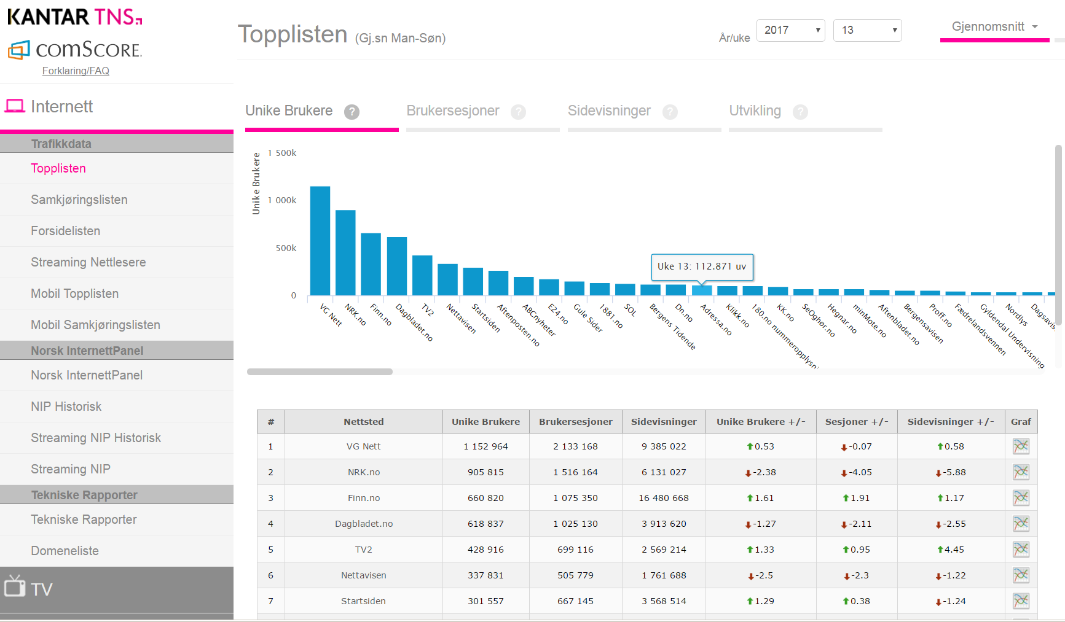
Reporting of media and TGI data
The data will still be reported in Gallup PC.
All digital figures from desktop, tablets and mobile will be monthly calibrated from comScore official online data into Gallup PC.
A new web-based site, MediePortalen, with monthly updated of online data.
The official figures from the NRS for newspapers, magazines, radio, TV, social media.
Notes:
The data will still be reported in Gallup PC that is the most used media analytics in the market. All digital figures from desktop, tablets and mobile will be monthly calibrated from comScore official online data into Gallup PC.
Kantar TNS will launch a new web site, MediePortalen, with monthly updates of online data. The official figures from the NRS for newspapers and magazines will also be presented. Since Kantar TNS also measure and report radio, TV and social media we will be able to present all of the official figures on one site. This will strengthen the attention of the media currencies in Norway.

Slide 32
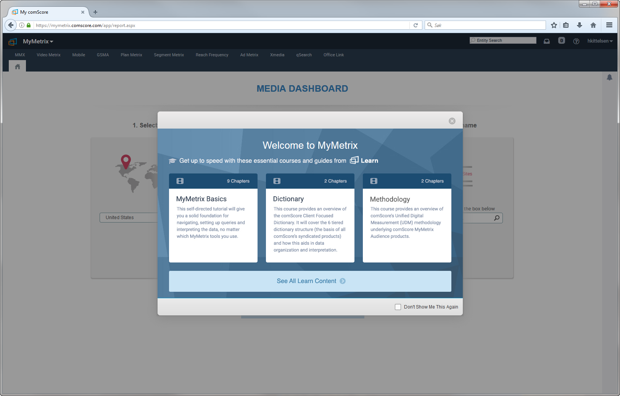
Reporting of online currency from comScore
MMX Multiplatform Audience Analytics as part of the comScore MyMetrix platform
‘Direct’ for tagging customers
vCE for campaign measurements
data handoffs for third party software's
VMX for video measurements
Notes:
Reporting of Online Currency from comScore.
MMX Multiplatform Audience Analytics as part of the comScore MyMetrix platform and gives different metrics.

Slide 33

7. Future perspectives

Slide 34
The first combined contract for print and digital with the aim of developing ecosystems controlled by the publishers
Newspaper readership measurements will still be collected by CATI.
The magazine measurements will be carried out by CAWI with a device agnostic approach.
The new system will measure and report reach and frequency across platforms, screens and devices.
The digital figures that will be published and reported in Gallup PC will be calibrated to match the official digital figures delivered by comScore.
The total media footprint for all media will be reported in Gallup PC.
Notes:
To wrap up we are proud of having established the first combined contract for print and digital with the aim of developing ecosystems controlled by the publishers.
Newspaper readership measurements will still be collected by CATI.
The magazine measurements will be carried out by CAWI with a device agnostic approach.
The new system will measure and report reach and frequency across platforms, screens and devices.
The digital figures will be published and reported in Gallup PC, and will be calibrated to match the official digital figures delivered by comScore.
The total media footprint for all media will be reported in Gallup PC.

Slide 35
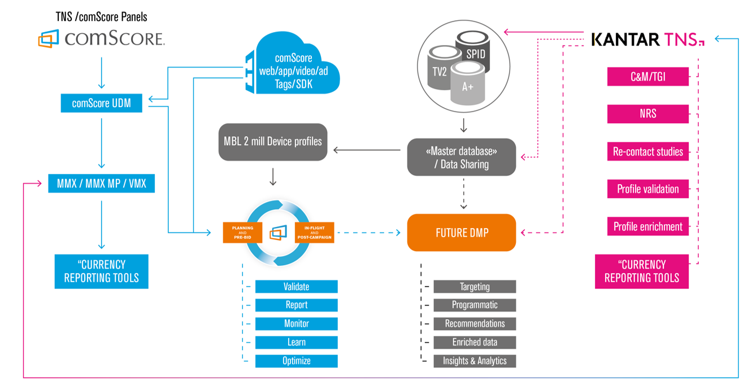
New eco-systems
Not part of the contract –
future plans
?
s
Notes:
Kantar TNS is eager to develop and build a new eco-systems together with the Norwegian media.
Kantar TNS will provide unique media data and consumer data from the TGI of high quality. We also have the opportunity to conduct Re-contact studies, profile validation, and profile enrichment.
Together with comScore we will deliver official online data and advanced reporting systems. We are able to be strategic partners with the Norwegian media and provide them with data and analytic tools to compete with the global companies like Facebook and Google.
KLIKK
The development of databases and DMPs is not part of the contract, but it gives the media huge possibilities for the development of sustainable new eco-systems.

Slide 36

Knut-Arne Futsæter Kantar TNS http://www.tns-gallup.no/medier
@Futsaeter
Notes:
MBL and Kantar TNS have just started this new challenging, demanding and exciting journey towards new eco-systems in a continuously and rapidly changing new media and technology landscape.
Bente and I hope we can tell you more about this journey next year.
Thank you for the attention!

